Slide 1
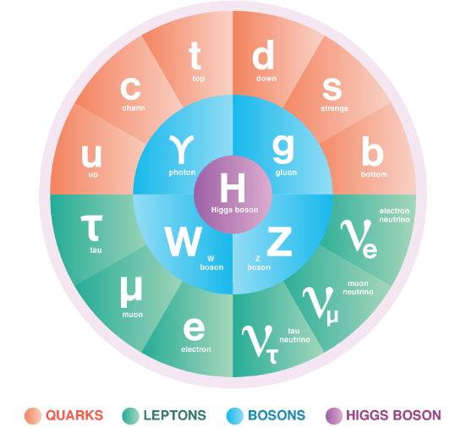
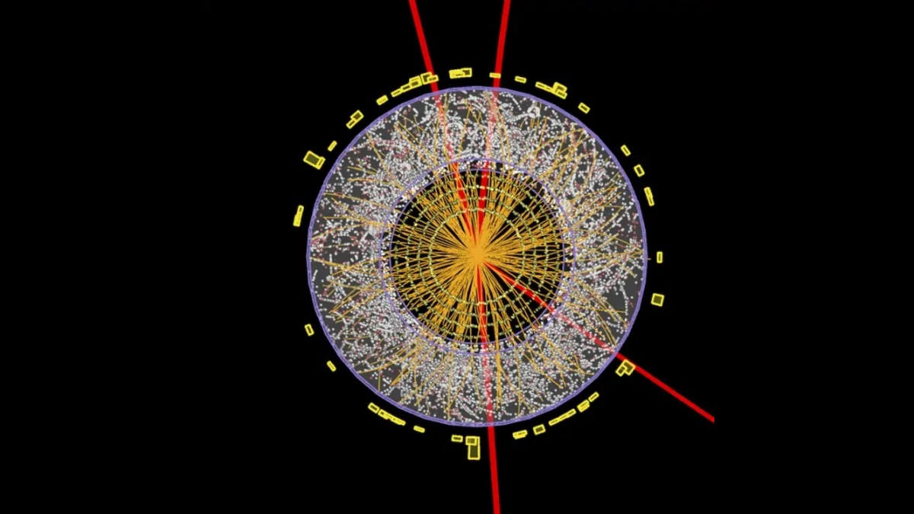
What and How?
Quarknet Masterclass 2024

Slide 2
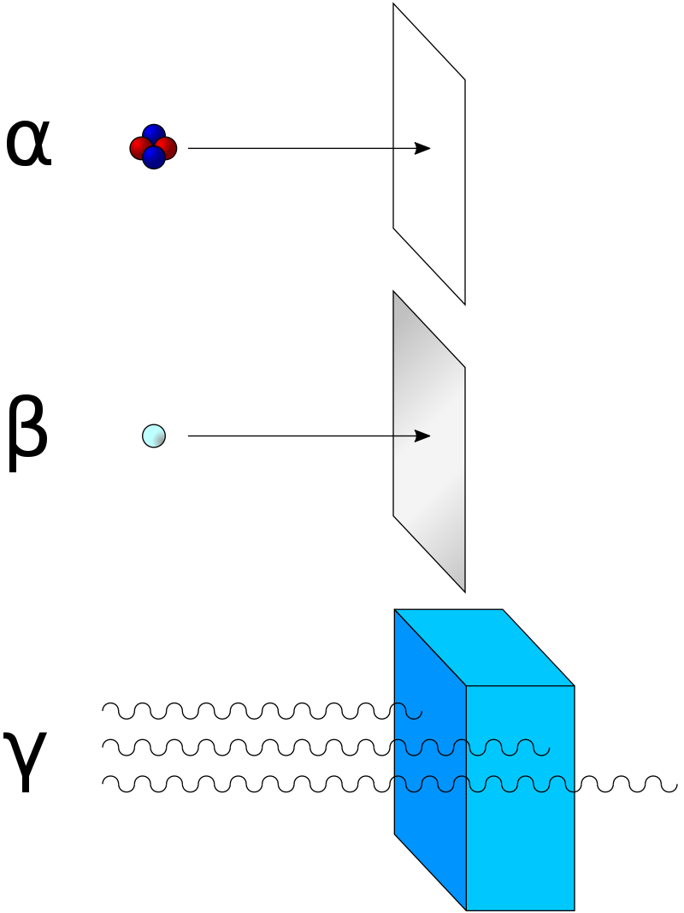
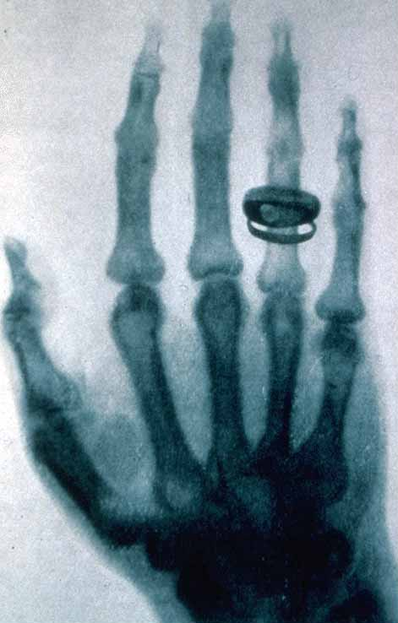
Roentgen, Becquerel, Curies, et al
Rays

Slide 3

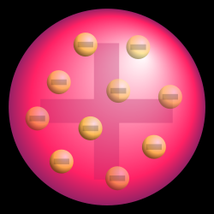
JJ Thomson
Constituents
Atoms have structure!
Cathode rays are particles!

Slide 4
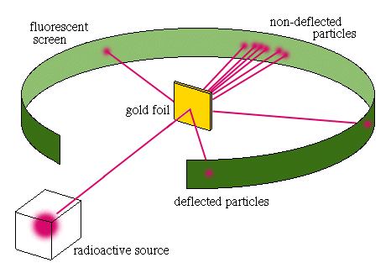
Rutherford (Geiger/Marsden)
Substructure
Nucleus!
First “Collider” Experiment

Slide 5
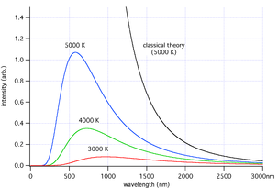
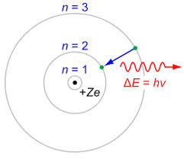
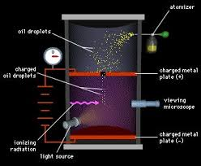
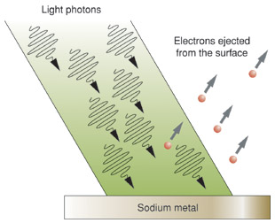
Plank, Millikan, Bohr, Einstein...
Quantization
Continuum → Quantum

Slide 6
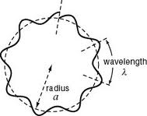
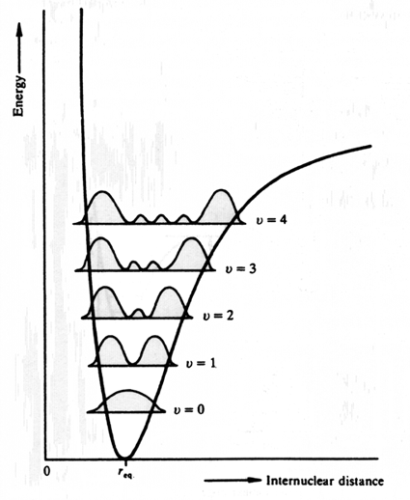
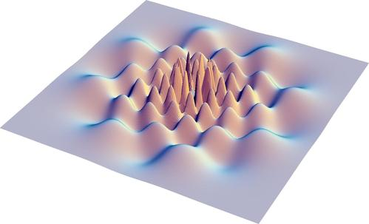
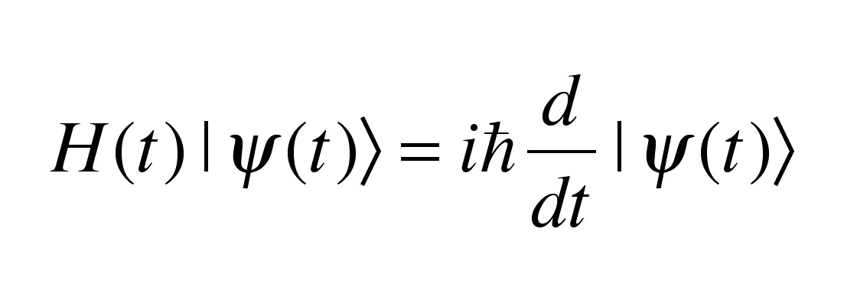
Schrodinger, DeBroglie, Born
Waves↔Particles
Wave Theories

Slide 7
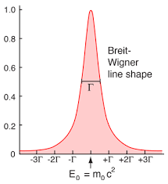
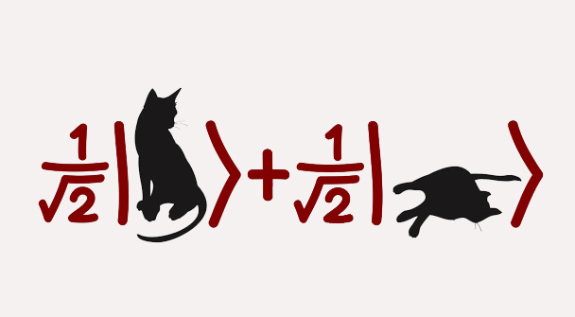
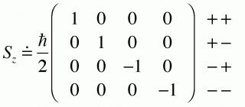

Heisenberg, Born, Jordan
Quantum weirdness
Quantum (Matrix) Mechanics
Uncertainty!

Slide 8
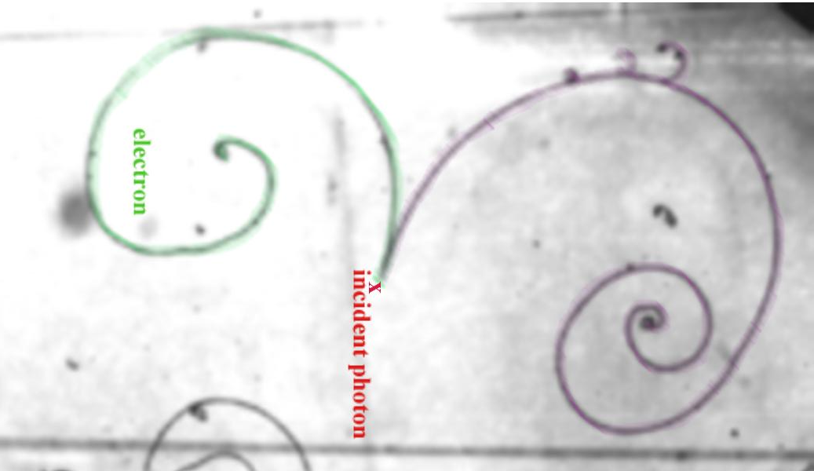
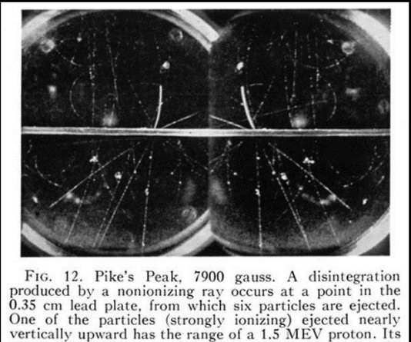
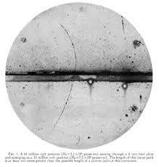
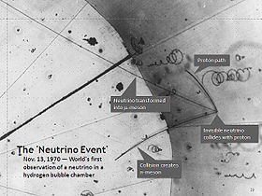
Pauli, Dirac, Fermi, Anderson...
New particles
New particles!

Slide 9
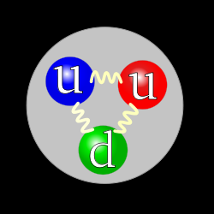
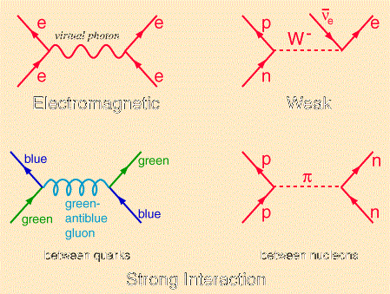
QFT

Slide 10
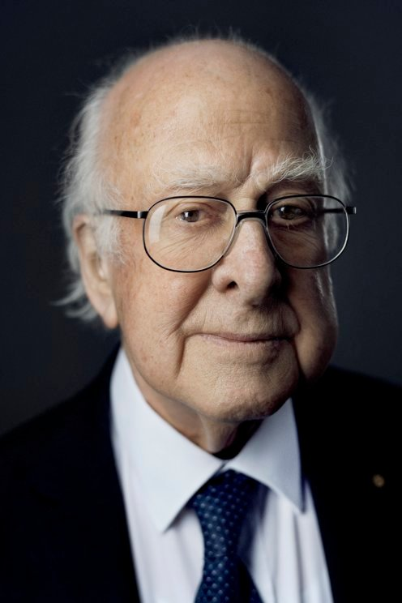
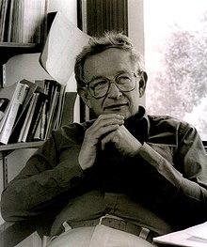
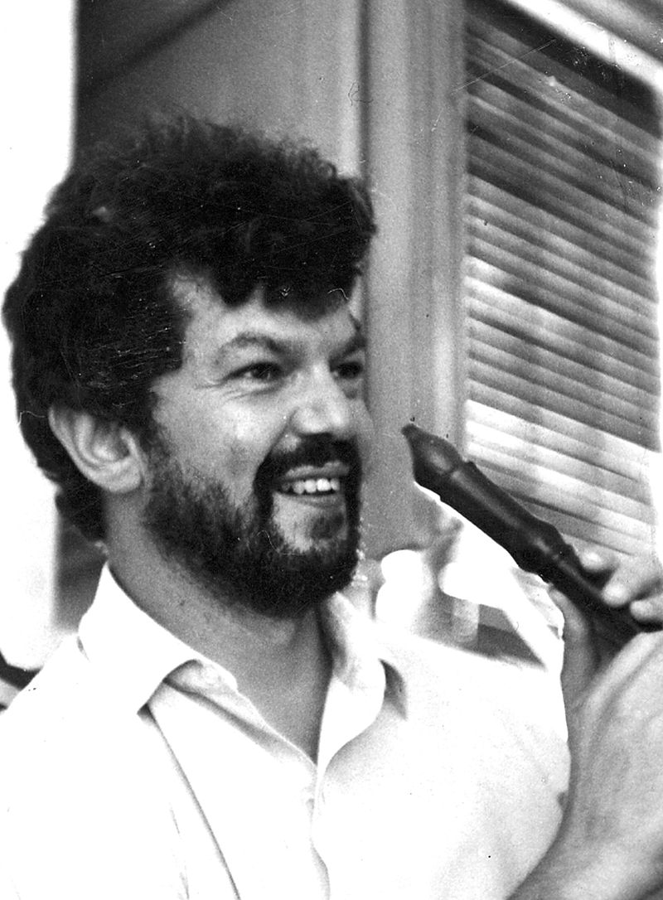
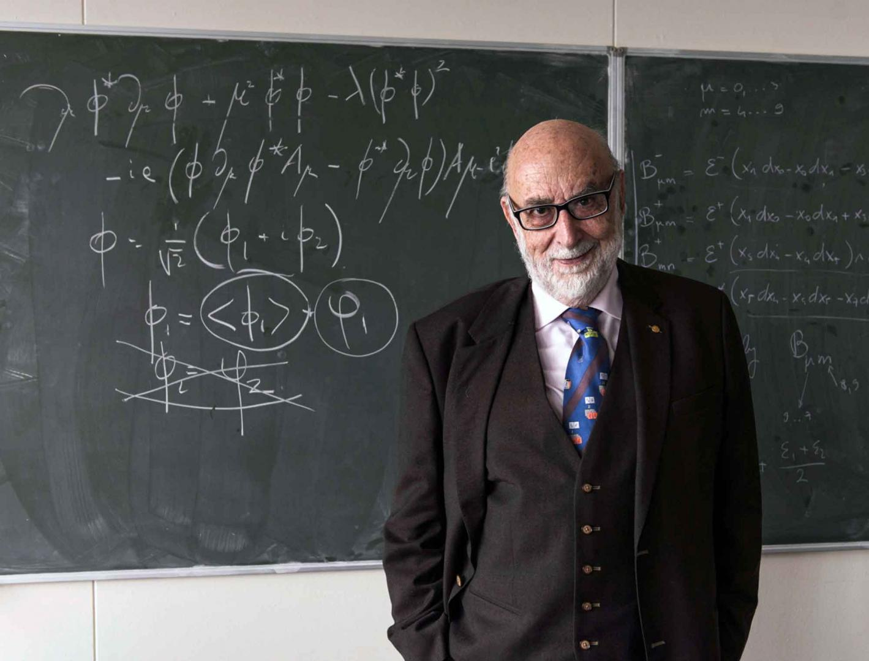
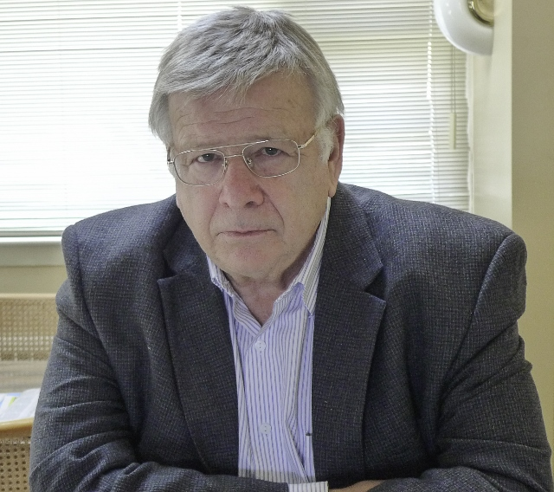
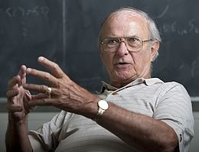
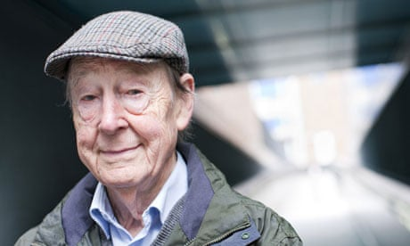
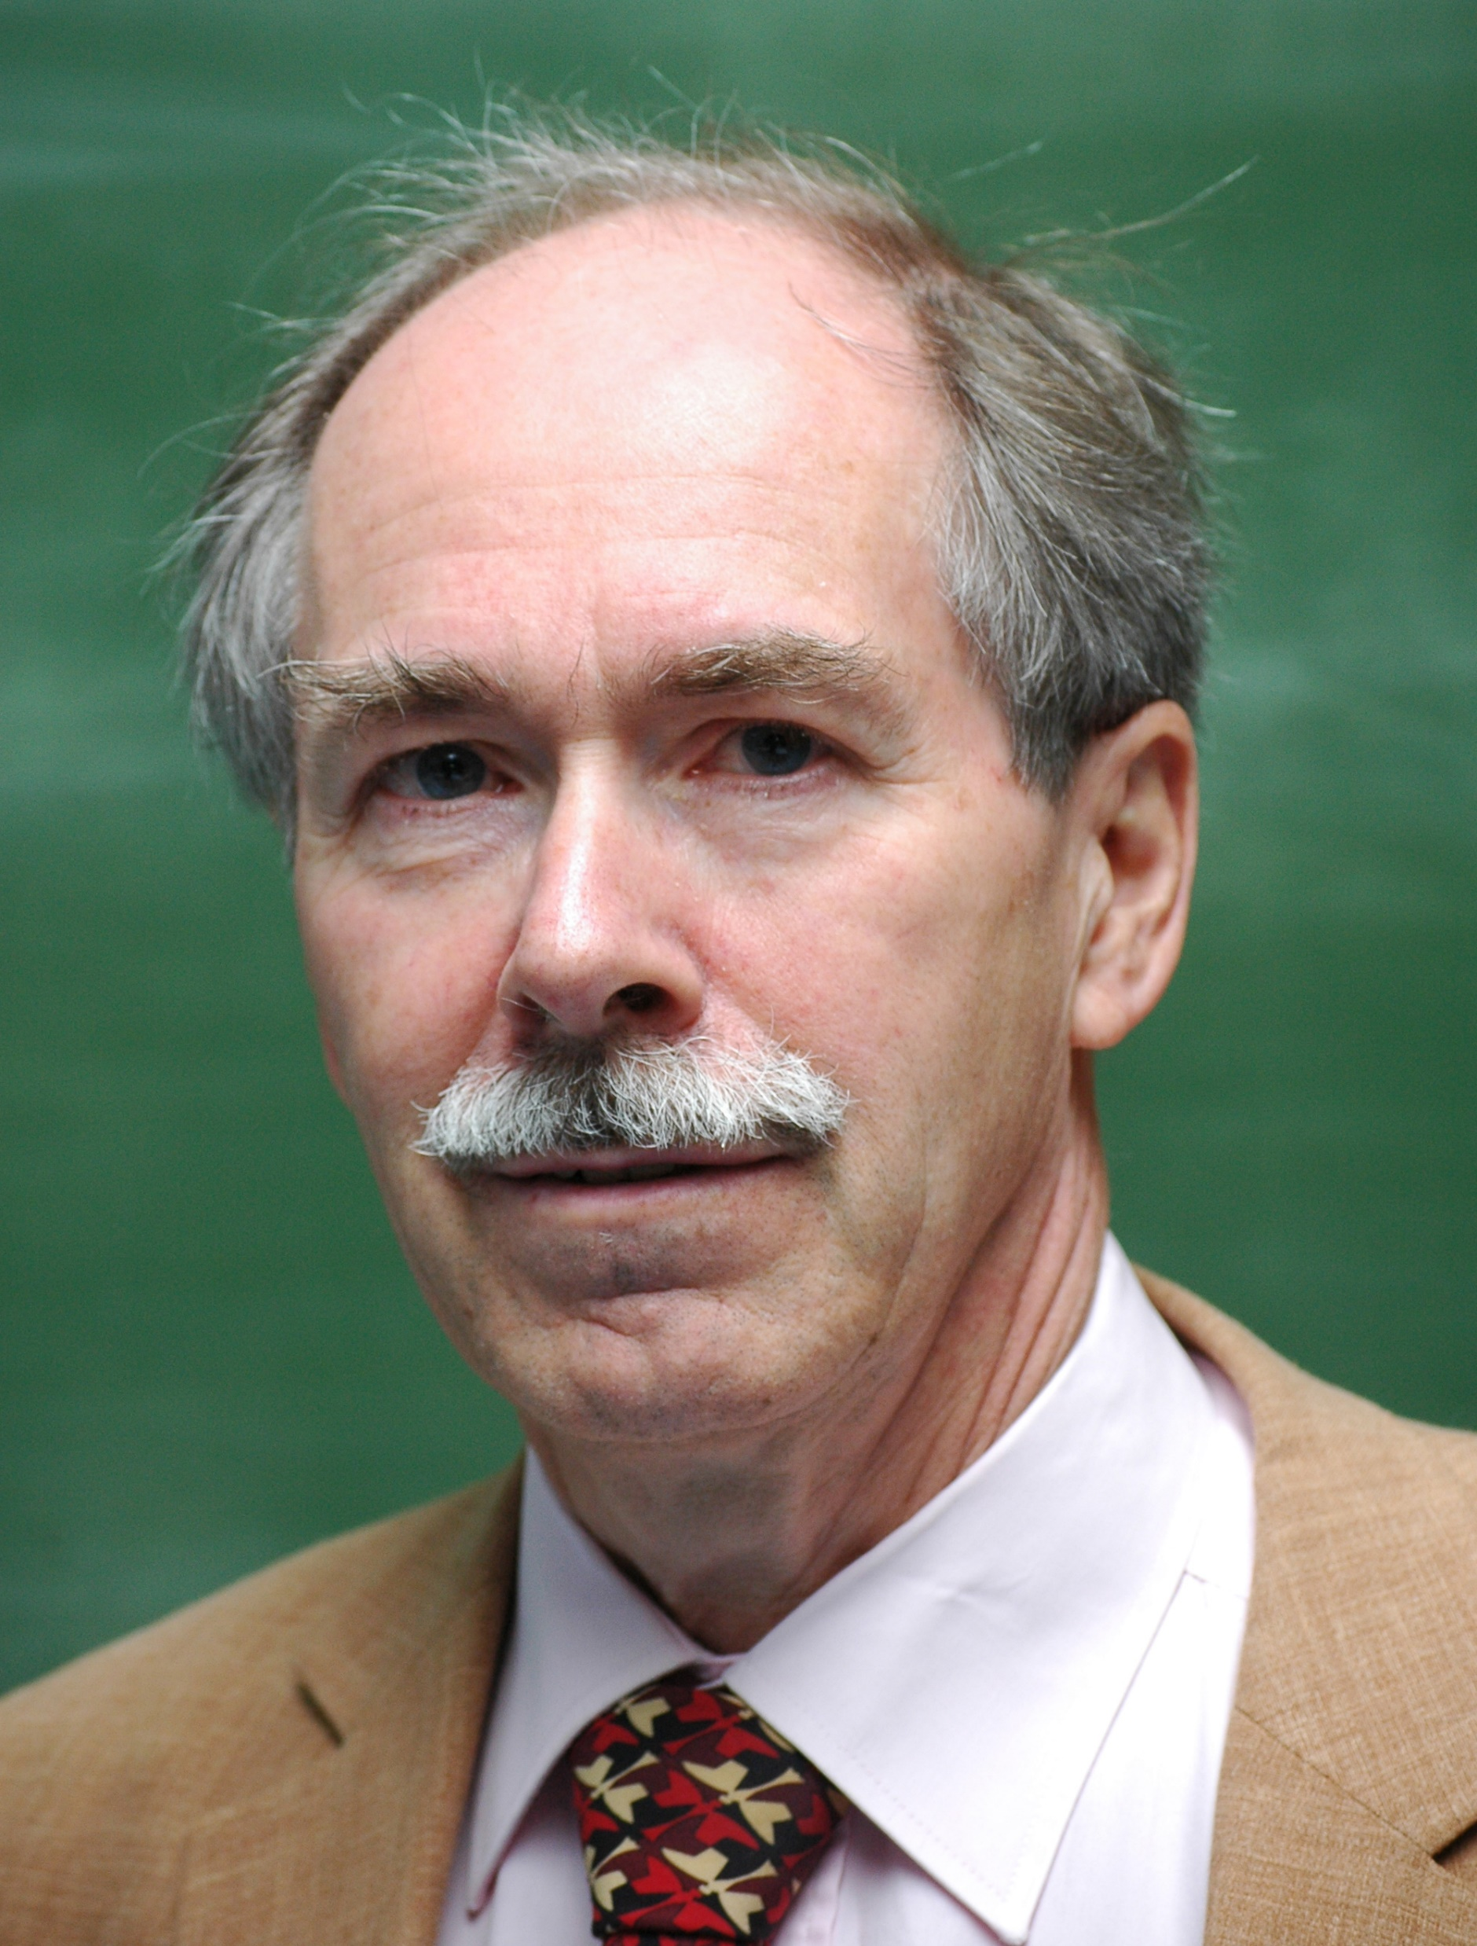

Slide 11
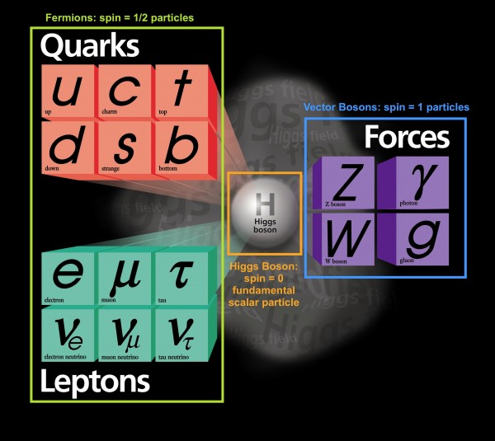
Coherence

Slide 12

Detectors

Slide 13
Striking gold
“First particle collider experiment”

Slide 14
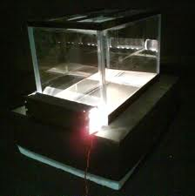
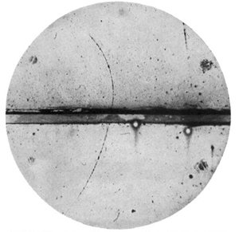
Cloud Chamber

Slide 15
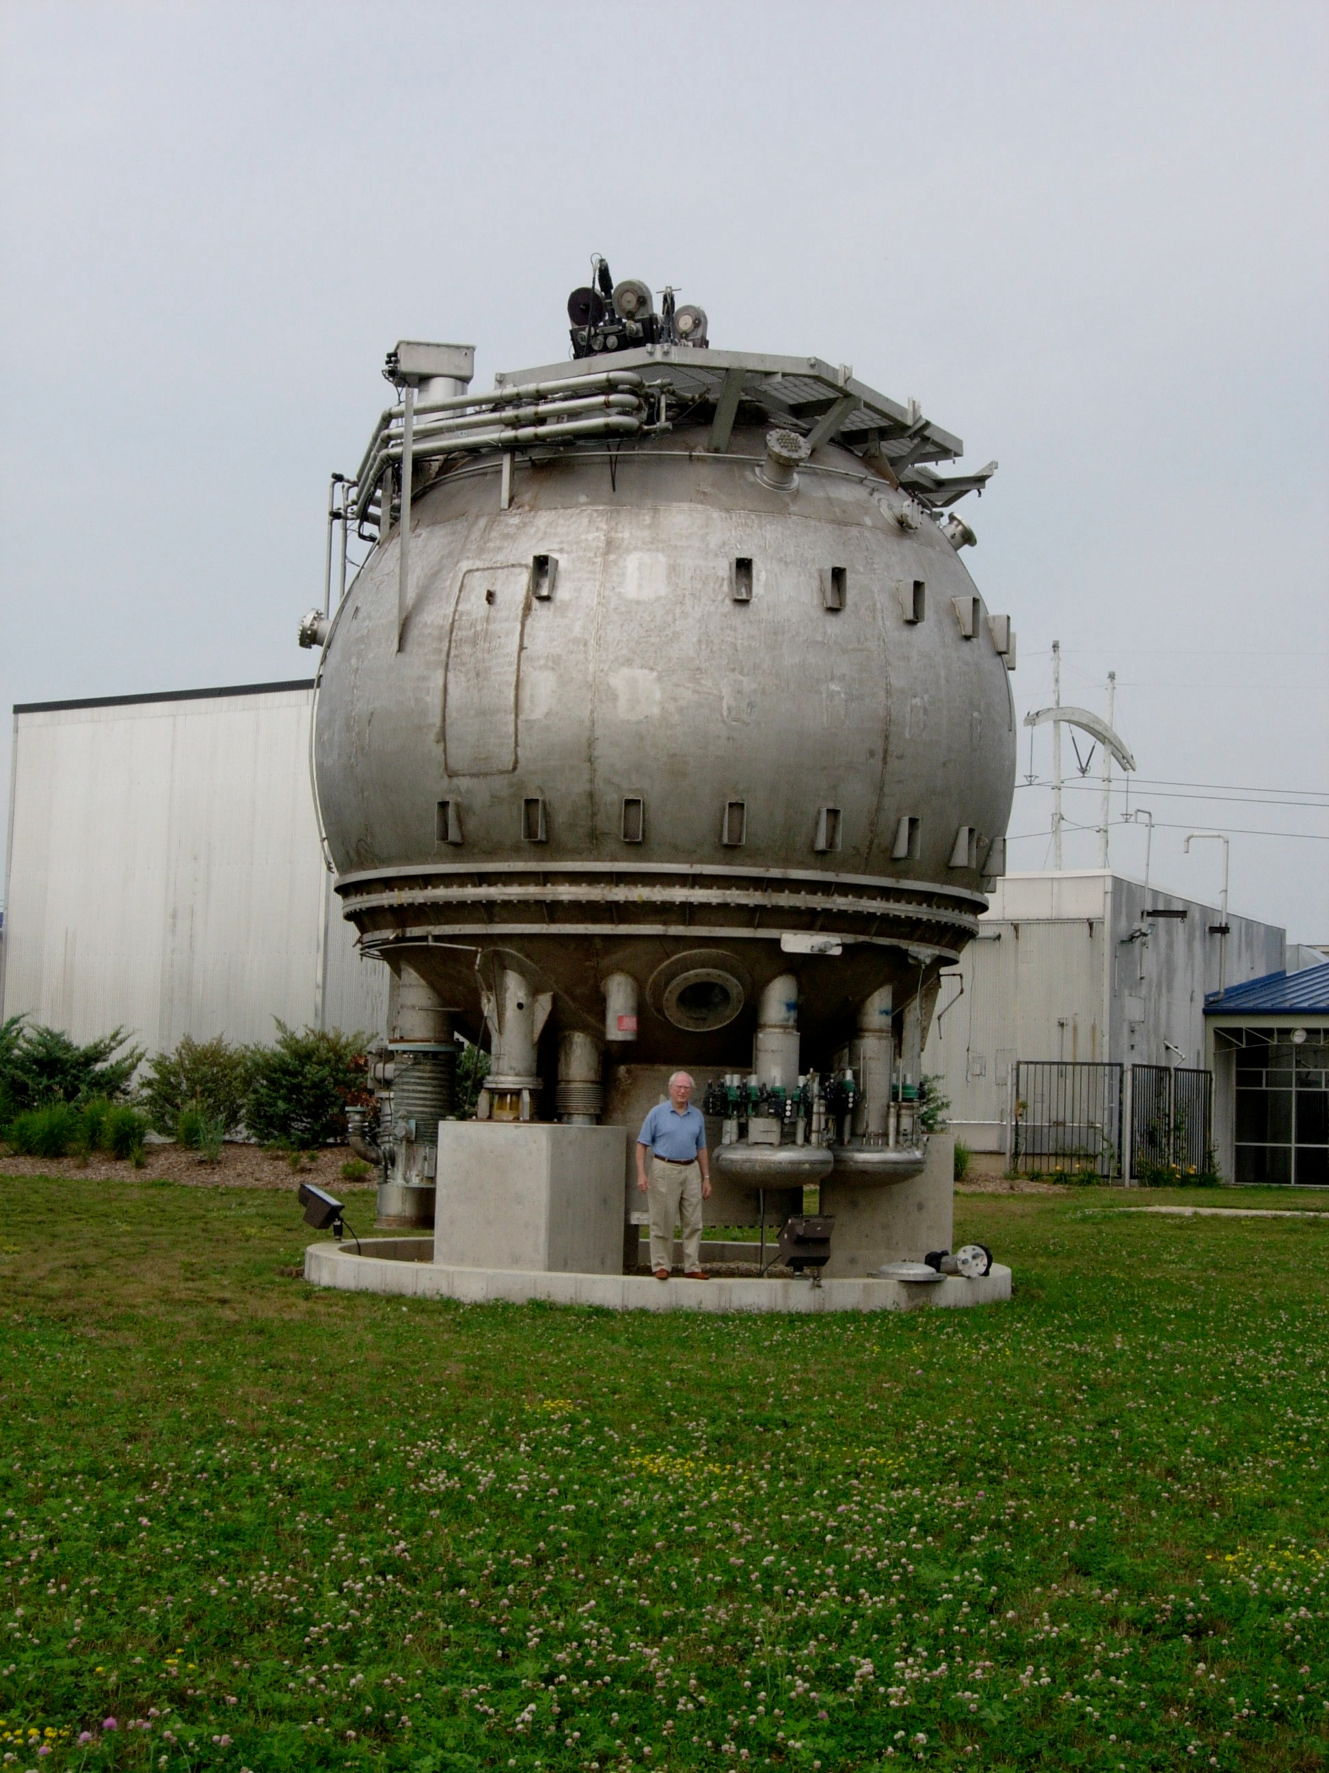
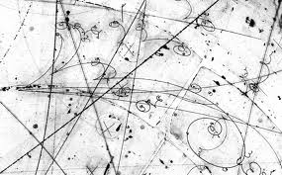
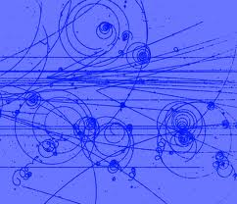
Bubble Chamber

Slide 16
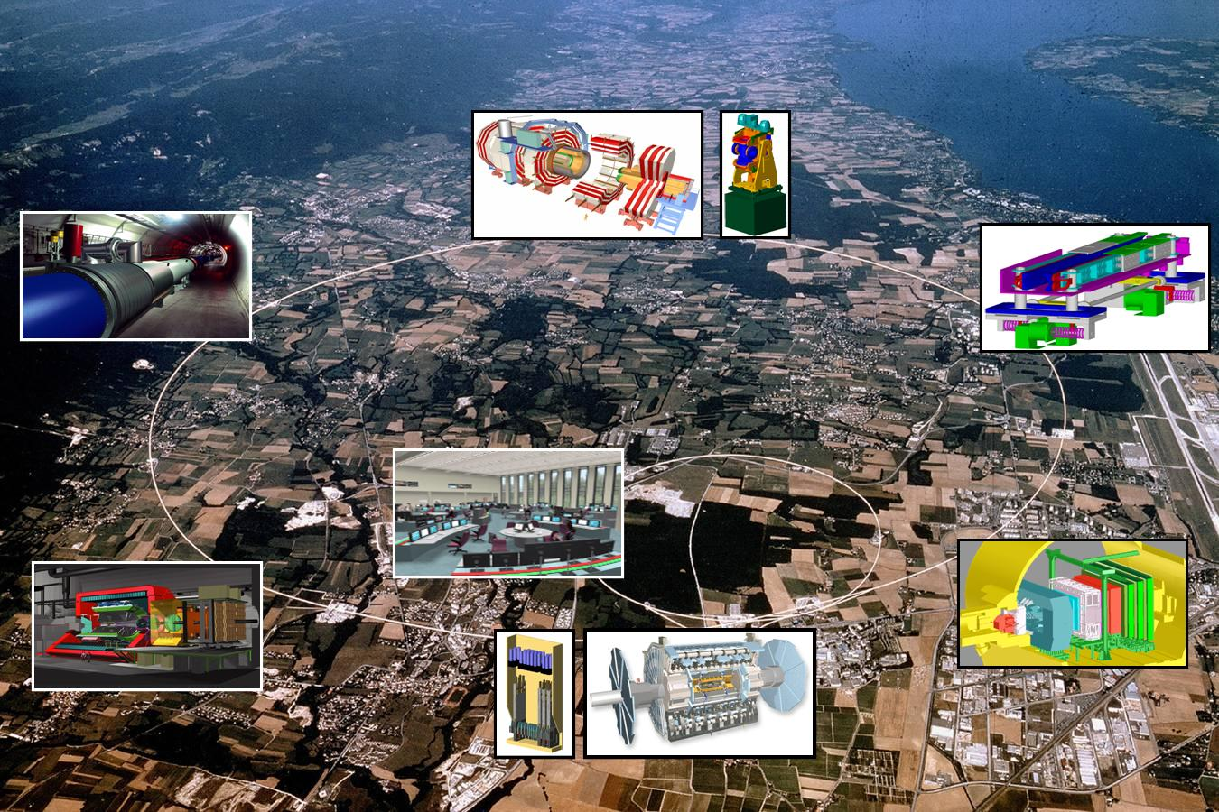
How do you get circles?

Slide 17
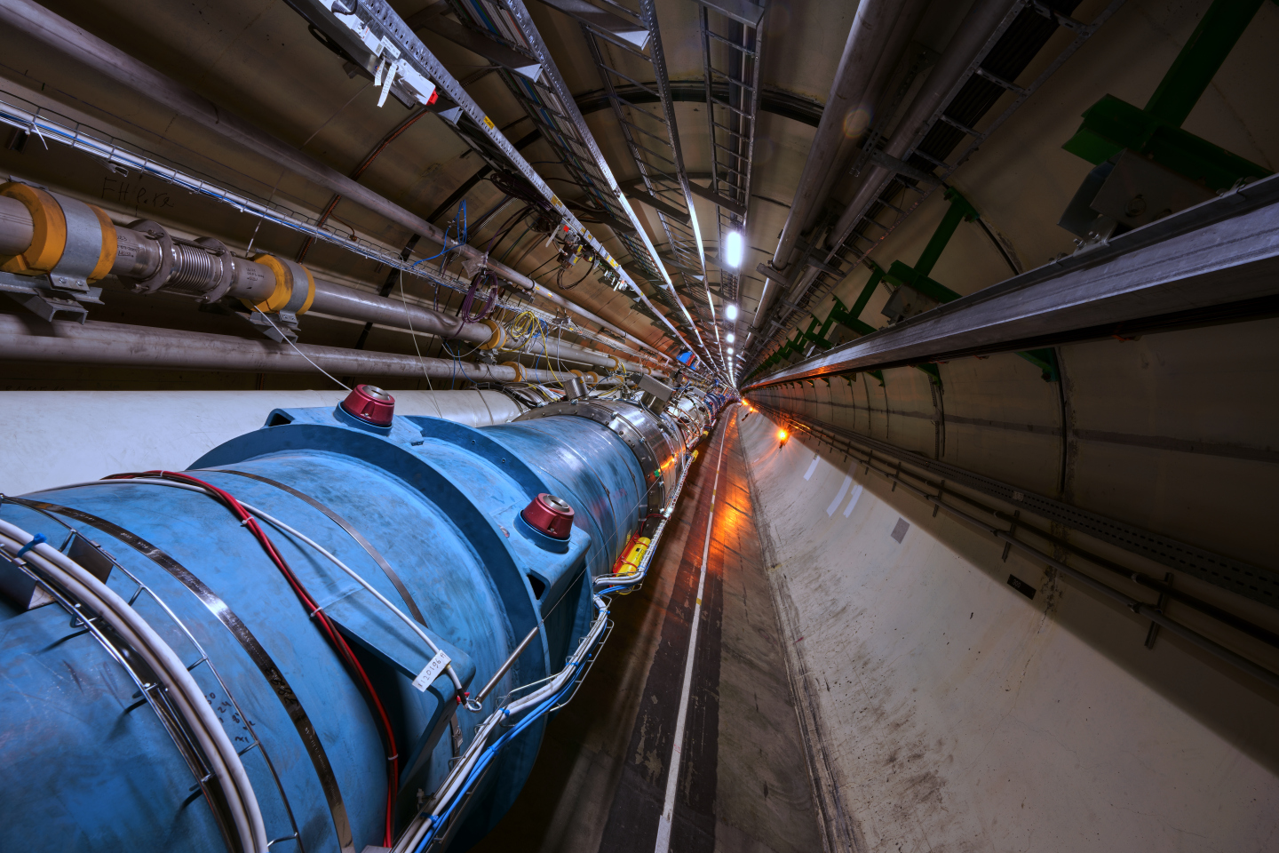
The LHC

Slide 18
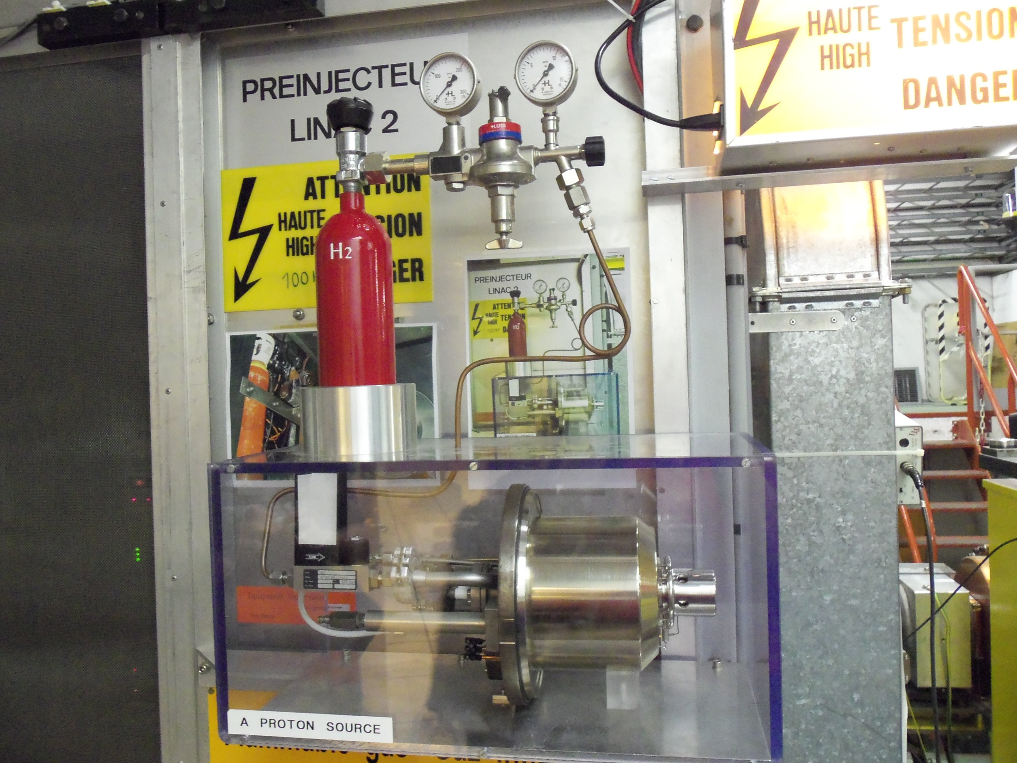

Slide 19
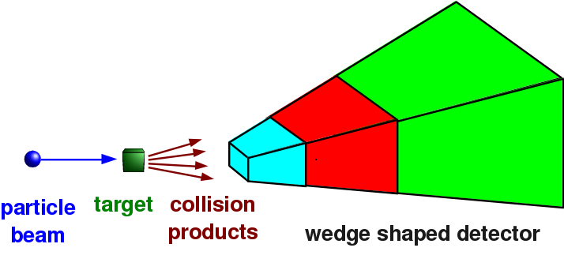
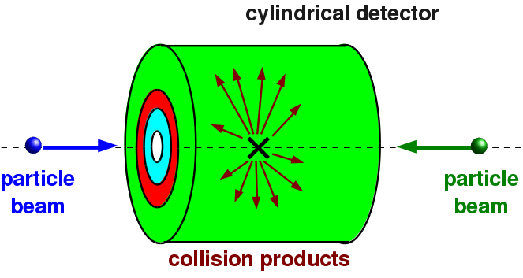
Experiment Types

Slide 20
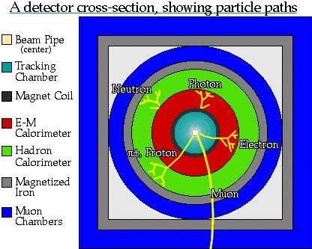
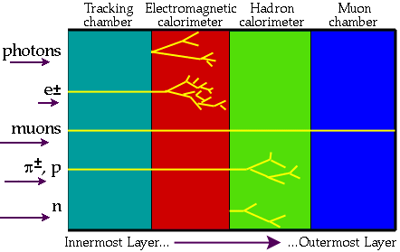
Detector Pieces

Slide 21
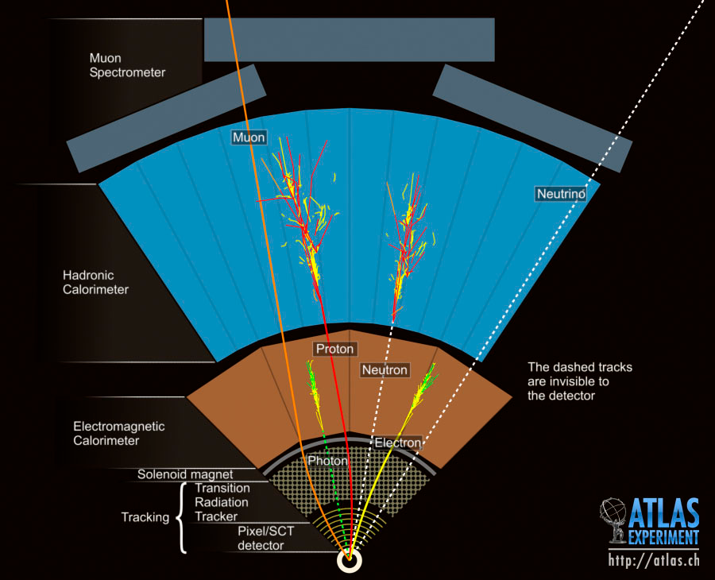
Detectors

Slide 22
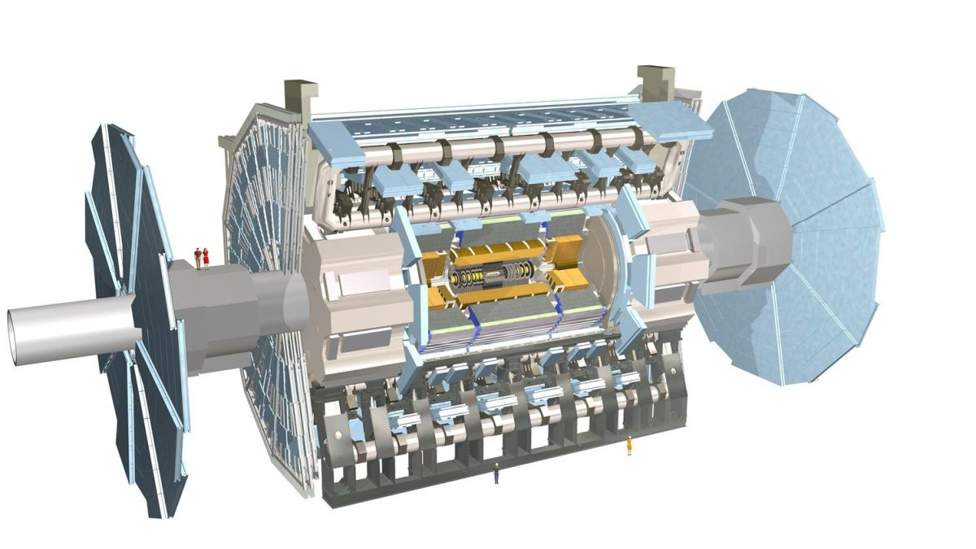
ATLAS

Slide 23
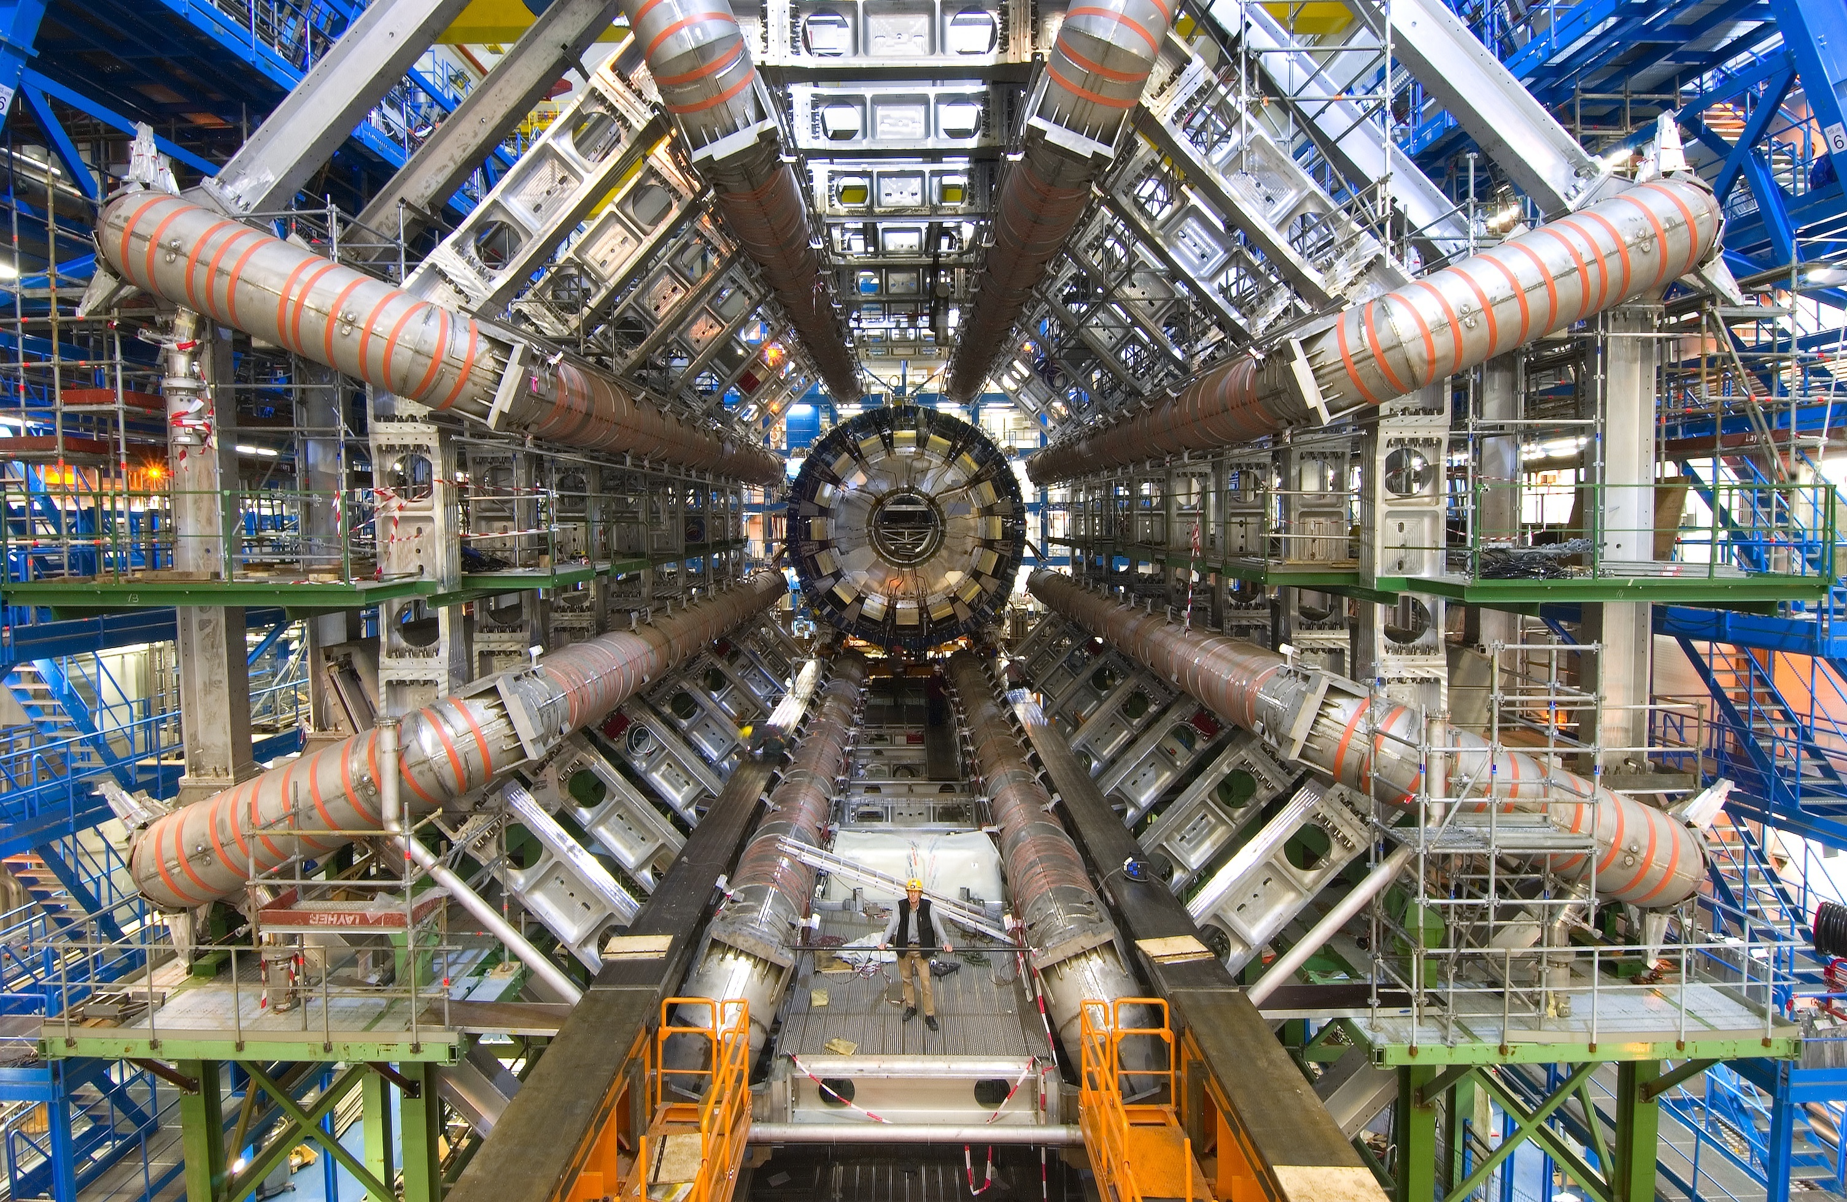
ATLAS

Slide 24

CMS

Slide 25

CMS

Slide 26
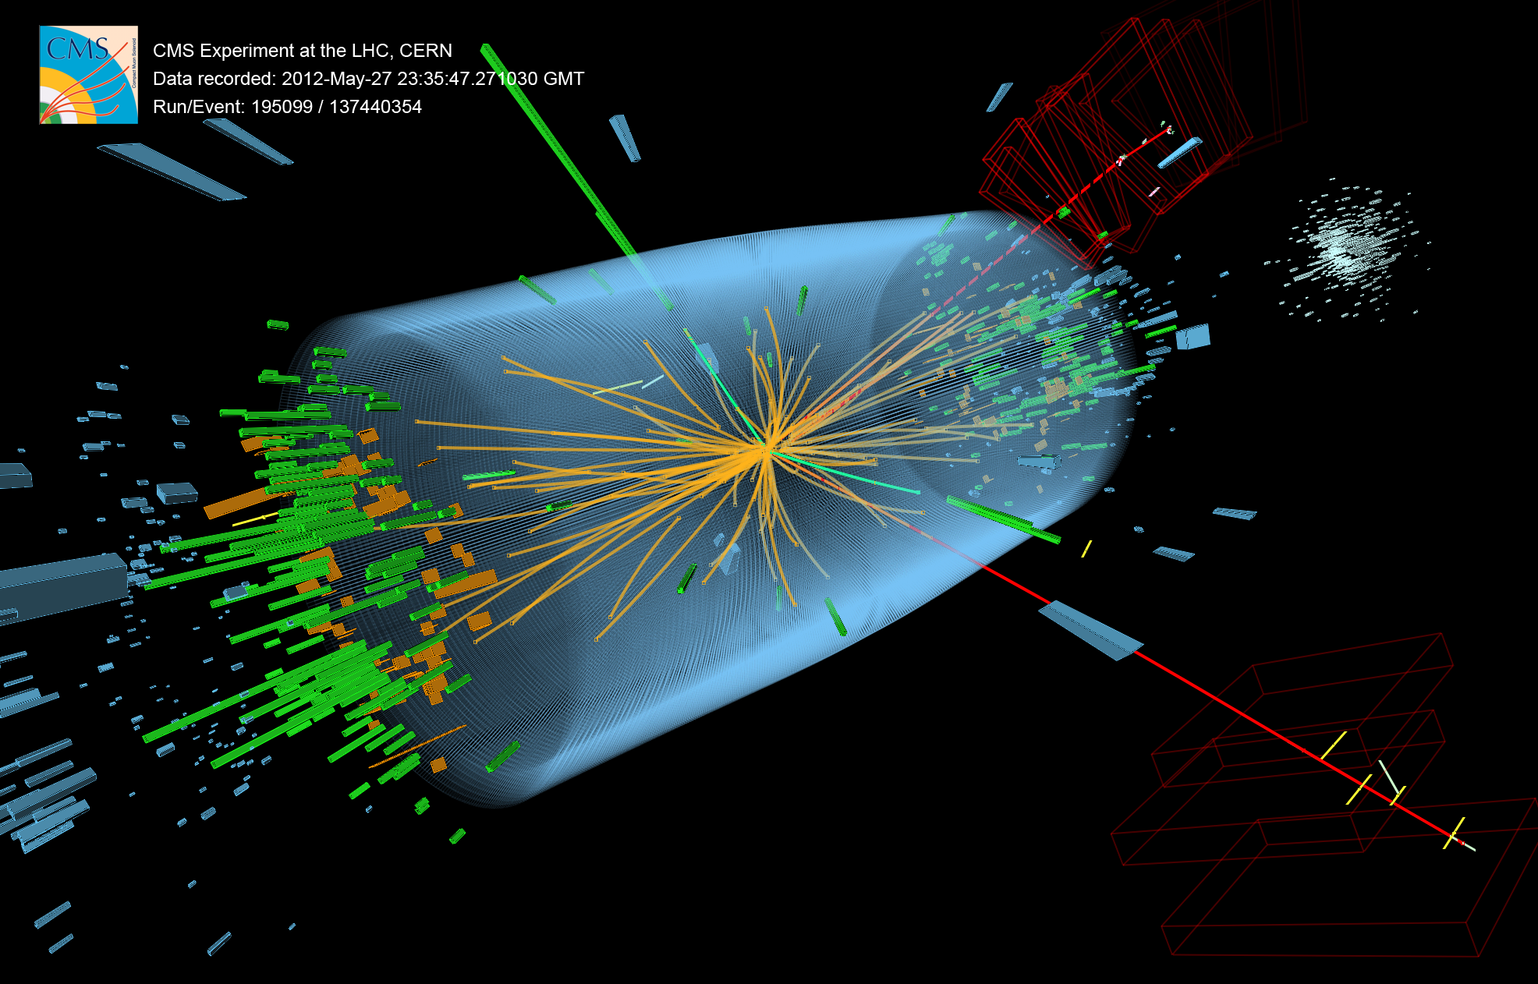

Slide 27
A Word About Units
Qty Formula SI Unit HEP Unit
Energy K~mv² Joule GeV
Mom. p=mv J/speed Gev/c
Mass m J/speed² Gev/c²

Slide 28
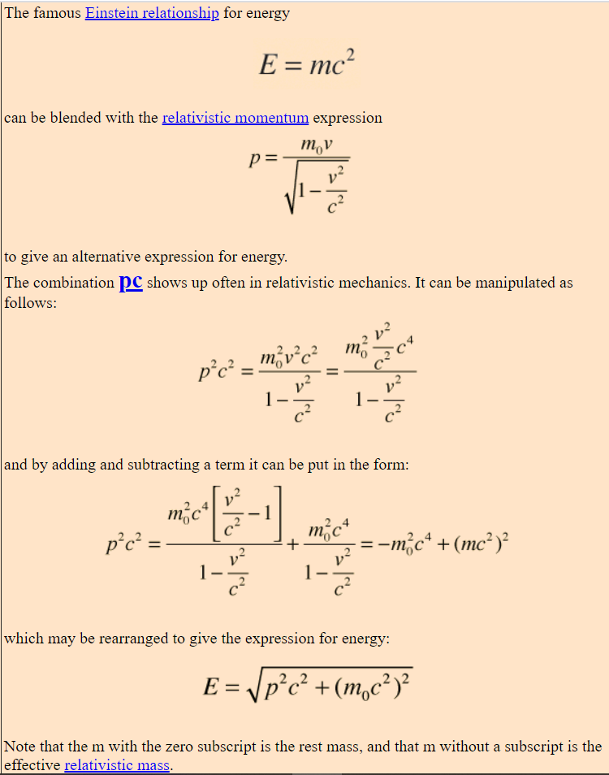



$E^{2}$=$p^{2}c^{2}$+ $m_{0}^{2}$ $c^{4}$
In the “natural units” system, c is often set to be 1 for convenience…
$E^{2}$=$p^{2}$+ $m_{0}^{2}$
Clean up and solve for mass…
m$=\sqrt{E^{2}−p^{2}}$

Slide 29
