Slide 1
Cosmic Ray Program
High School Long-term Collaboration
Using HEP Model
Inquiry-based learning with authentic research tasks.
Of 52 centers, 47 have hundreds of detectors (CRMDs) for experiments: muon flux; lifetime; speed.
Fermilab Support for QuarkNet – 3 Half-Time Positions:
Cosmic ray coordinator/fellows liaison (Mark)
Hardware support: Cosmic Ray Muon Detector (CRMD)(Dave)
IT & e-Lab analysis tools support (Edit)
Seed money for Cosmic Watch prototype

Slide 2
Maintenance & Growth
Long-term Options
CRMDs – Maintain current level
Recycle and re-assign CRMDs for QuarkNet teachers.
CRMDs are robust and sophisticated.
e-Lab – EQUIP->PyEQUIP; analyses; jupyter n.b.
Cosmic Watch
Build classroom audience with simpler intro activities.
Not a substitute for CRMD.
48 built at Notre Dame.
Field testing prototypes with fellows.

Slide 3
“International” CR Efforts?
Non-QNet Center Activities – both Int’l & U.S.
Participation in Meetings – community PR value
IPPOG Global Cosmics
Ken’s QuarkNet-like Groups (India; Japan; Taiwan; Africa)
Licensing of DAQs and hardware support
Fermilab/QuarkNet brand DAQ in the field
DESY - 100 DAQs used with their own muon counters
Participation in Data Activities
International Cosmic Day and International Muon Week
Pyramid imaging project

Slide 4
Usage Last Four Years
Three Eras: Pre-COVID – COVID – 2022
March 20: COVID-19 – Very limited access to CRMDs; teachers in survival mode.
DAQ/Uploads Comparison for 7-Month Periods Apr.–Oct.:
Pre-COVID Apr.–Oct. 2019 66 DAQs/2,173 uploads
COVID Apr.–Oct. 2020 27 DAQs/2,733 uploads
2021 Apr.–Oct. 2021 42 DAQs/2,871 uploads
2022 Apr.–Oct. 2022 55 DAQs/3,513 uploads
Analyses run during Octobers:
In Oct 2020 2,182 analyses from 26 DAQs
In Oct 2021 4,300 analyses from 30 DAQs
In Oct 2022 5,005 analyses from 34 DAQs
Conclusion: During COVID, there were fewer, but more active, users! Constantly improving.

Slide 5
Future & Special Projects
Cosmic Ray Fellows & Staff Spawn Exciting Projects
International Muon Week Low participation in 2022 – Fellows are building 2023 audience via monthly detector help sessions & videos.
Inexpensive detector (Cosmic Watch) – beginner classroom (ND FNAL) Fellows created activities, testing first prototypes for hardware issues.
Storm Tracking (KSU; UPRM; HI)
Solar Eclipse 2017 (U.S. Centers) Improving technique for total eclipse in 2024
Moon Shadow (UIC)
MUSE 2019 – Cosmic Rays in MINOS tunnel (UIC) Links CR and neutrinos.
Fellows developed virtual workshops; expand use of curated data
Post-Processing – More complex analyses with Coding Fellows, Jupyter notebooks - Fermilab HS Interns created upward muon search in 2022.
Pyramid Archaeometry at Chichen Itza (CSU; DU)

Slide 6
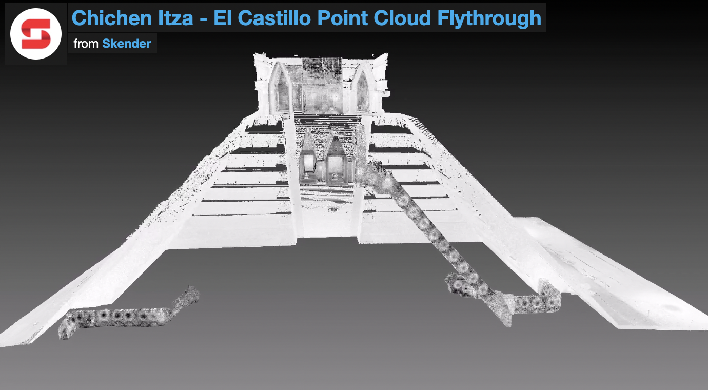
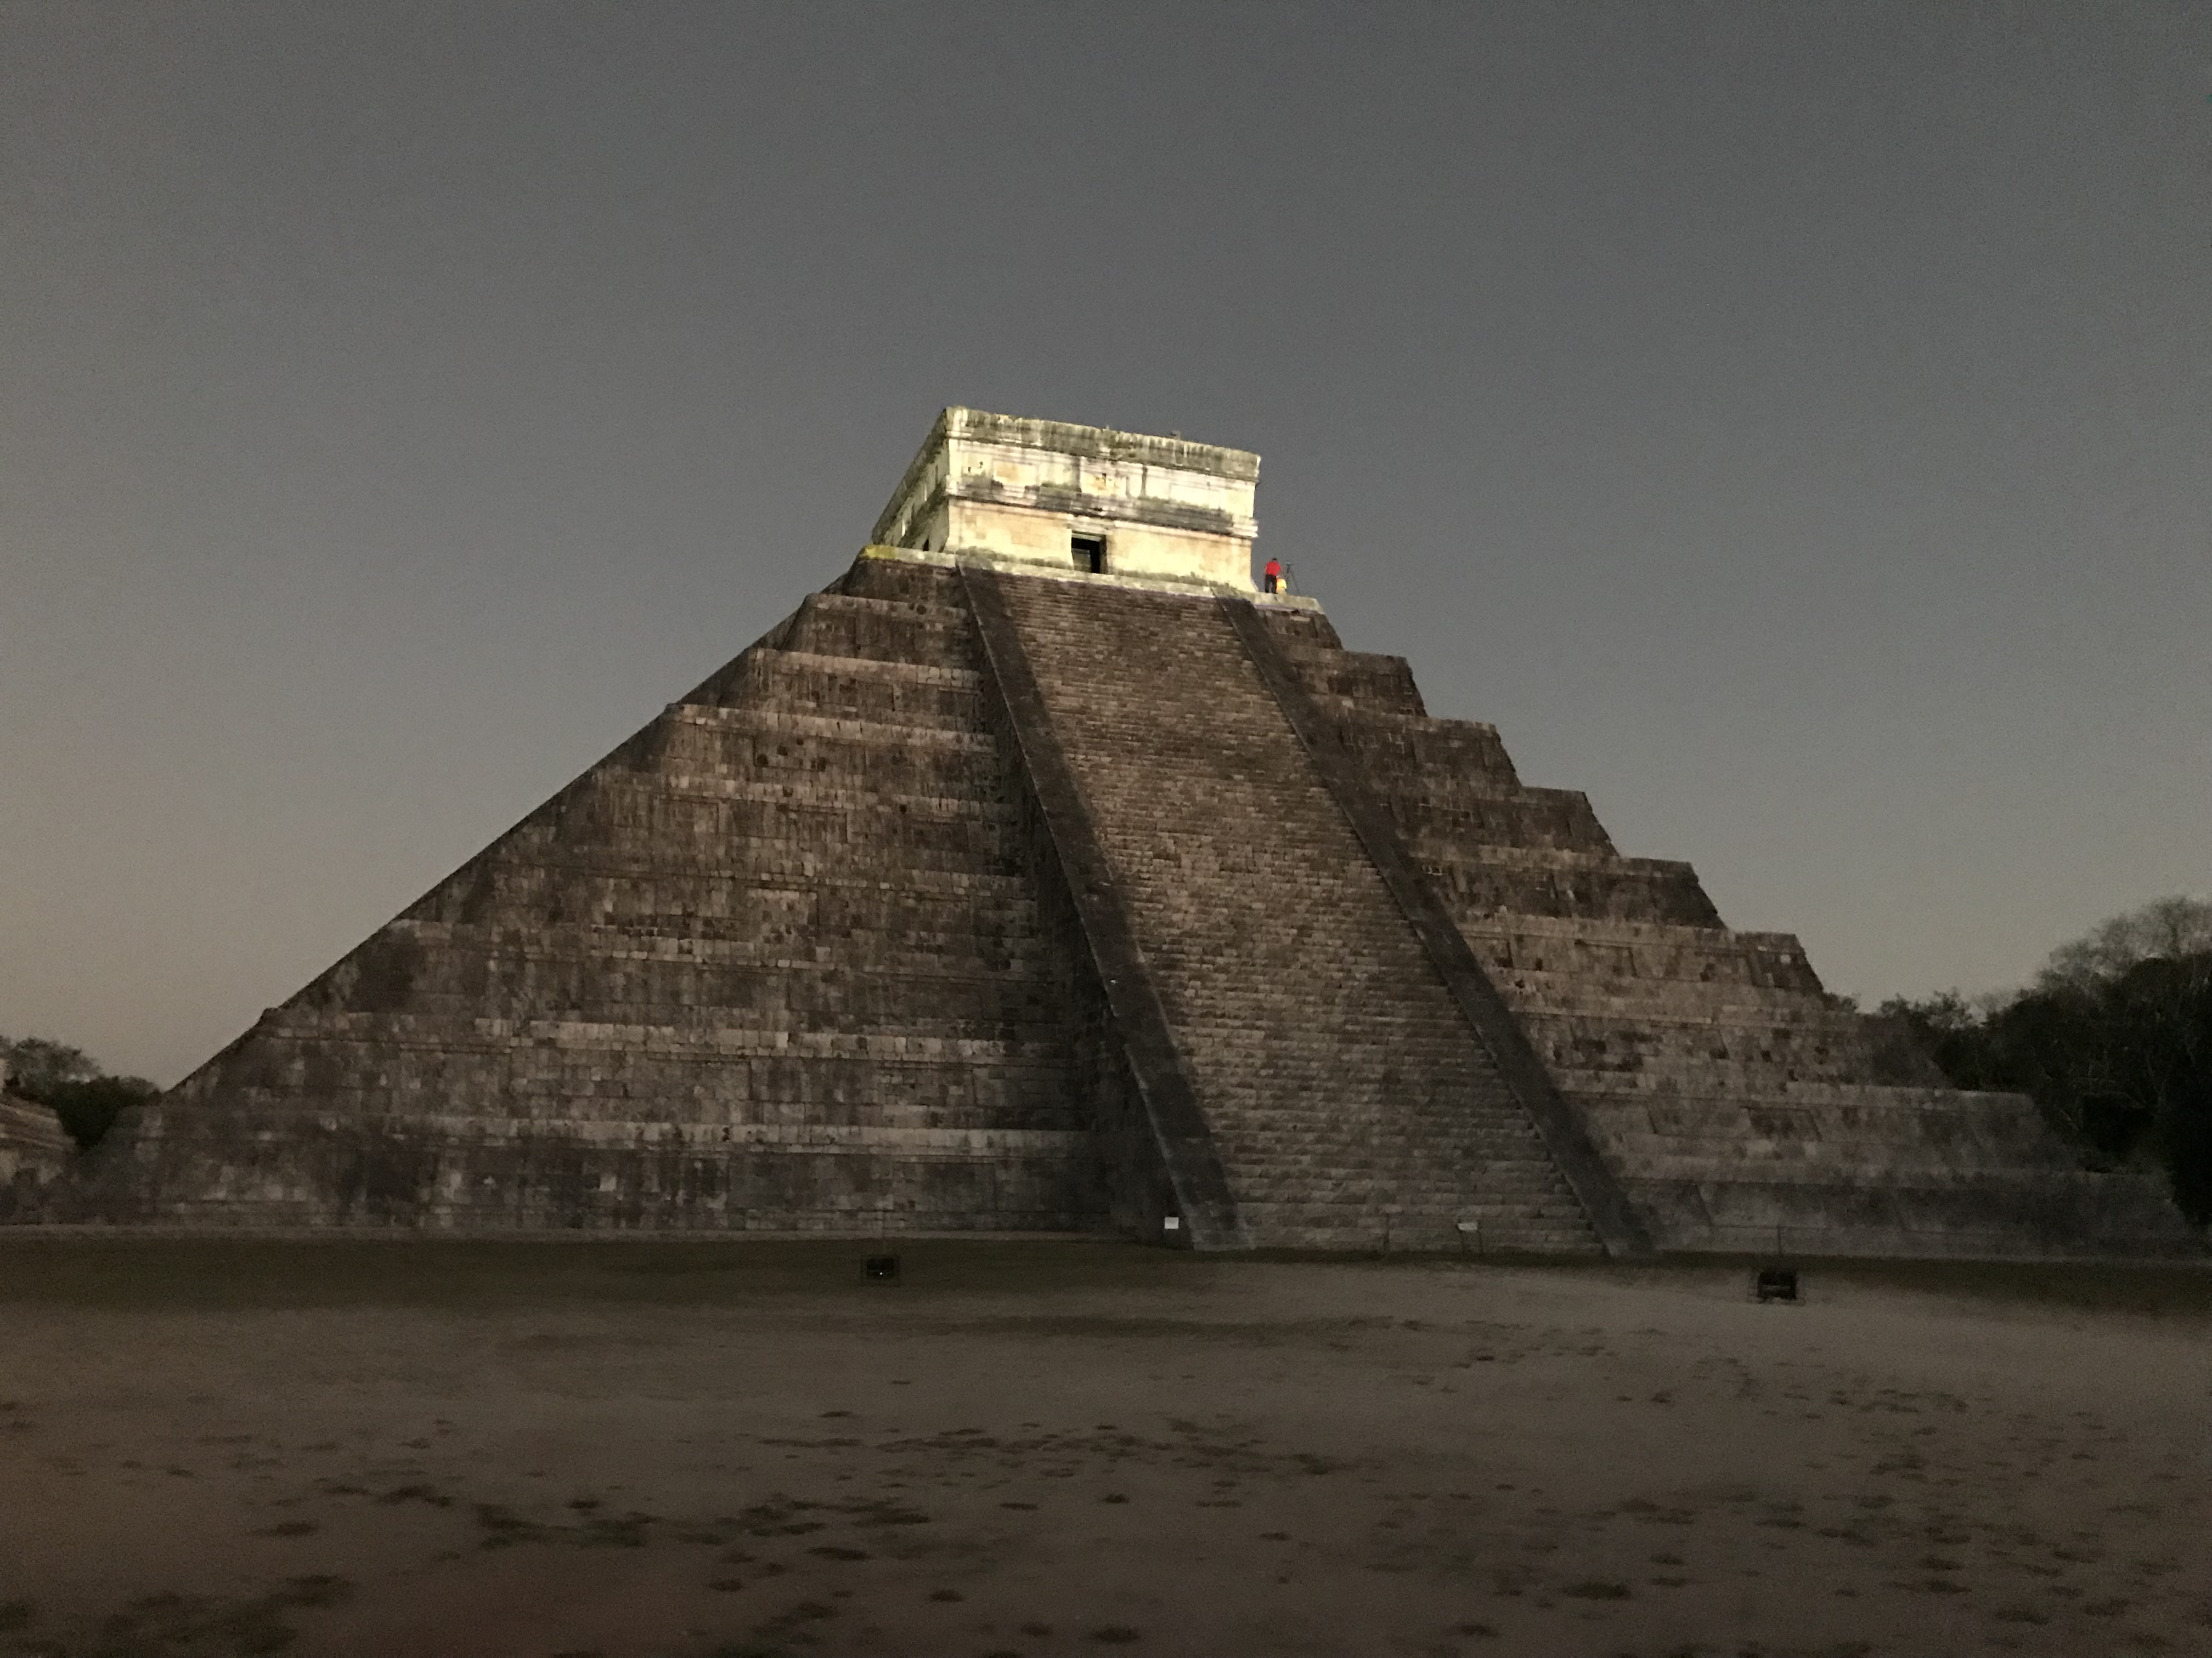
QuarkNet collaborates with NSF Muography Project
QuarkNet plans to host data on e-Lab and develop displays and public analyses.
Search for hidden chambers

Slide 7
Cosmic Rays – International
Global Outreach Activities
IPPOG – Global Cosmics follows masterclass examples.
International Cosmic Day (DESY) in November.
International Muon Week (QuarkNet-Fermilab) in March. (fellows run)
Eclipse Project 2017 (30 U.S. high schools plus several non-U.S. locations)
Teacher presentations at AAPT, ICRC 2019, 2021, and 2022.
DAQ Licensing (Goodwill for FNAL)
400 DAQs in 31 countries used for outreach & research.
Uploads from 92 DAQs in 27 countries.

