Slide 1
Applications of Isotopes at BNL
Cathy S. Cutler, Strategic Advisor of the Isotope Research and Production Department, Brookhaven National Laboratory
Immediate Past President of the SNMMI

Slide 2
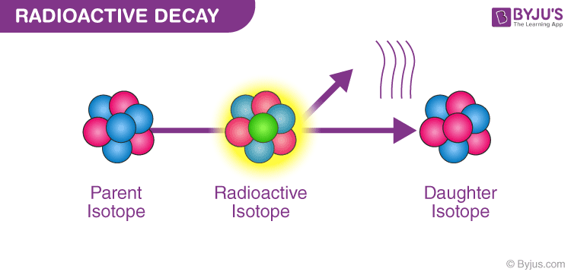
What is radioactivity?
Unstable nucleus of an atom “decays”
  Emits energy/particles (α, β⁻, β⁺, γ) to become stable
Sometimes things are naturally radioactive
Sometimes scientist force things to become radioactive

Slide 3
Radiopharmaceuticals
Radiopharmaceuticals - Drugs that contain radioactive atoms
Radiopharmaceuticals are used for imaging and therapy
Diagnostic radiopharmaceuticals have no pharmacological effect
  Examples:
    Heart disease (e.g., ^{99m}Tc, ¹⁸F, ⁸²Rb)
    Cancer (e.g., ¹⁸F, ⁶⁸Ga)
Therapeutic radiopharmaceuticals deliver radiation therapy directly to a lesion
  Examples:
    Seeds for prostate cancer therapy (¹⁹²Ir)
    Targeted therapy (⁹⁰Y, ¹³¹I, ²²³Ra,¹⁷⁷ Lu)
More than 20 million nuclear medicine procedures are performed each year in the US, ~ 50% of the global market
Nuclear medicine is ~ $2 billion USD/year industry
The health benefits and economic impact are enormous

Slide 4
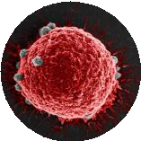
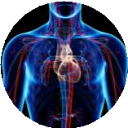
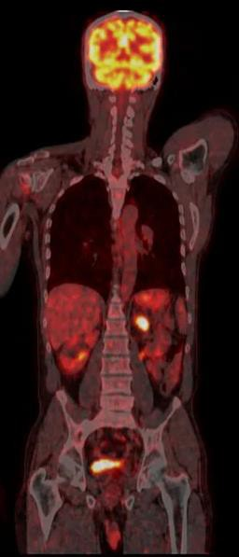
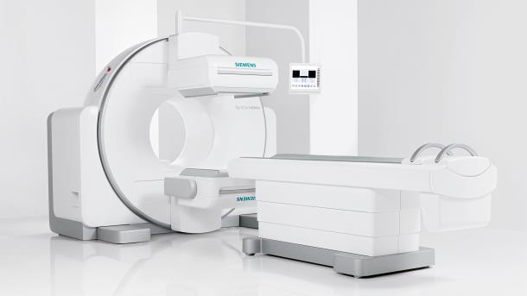

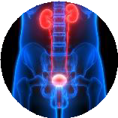
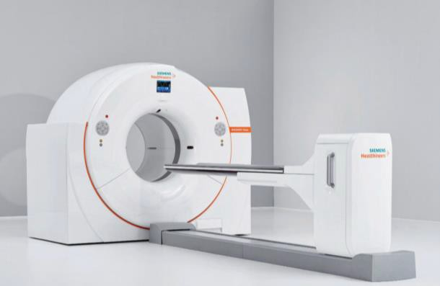
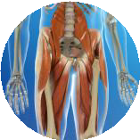
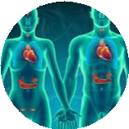
Applications of
Nuclear Medicine
Detection of
cancer and its spread
Imaging
SPECT
Detection and monitoring of
cardiovascular diseases
Identification of
neurologic and psychiatric diseases
Imaging of normal and abnormal functions of
excretory organs
PET
Identification of regional tissue damage due to
infection or trauma
Identification and quantification of
endocrine disorders
Slide: 4/19

Slide 5
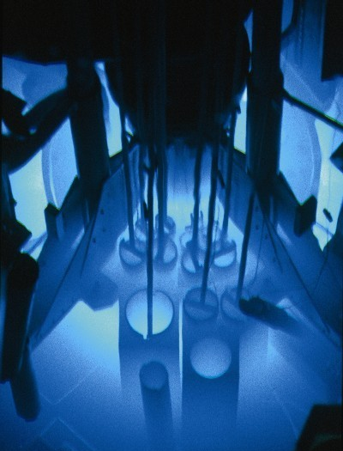
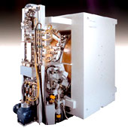
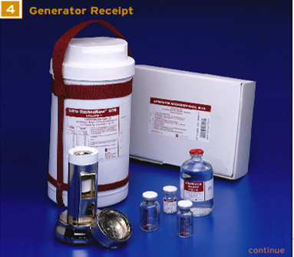
How are radioisotopes produced?
Reactors
Accelerators
Generators

Slide 6

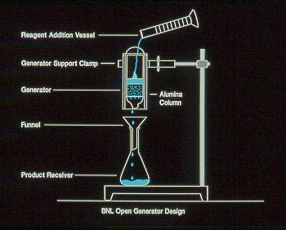
The Radioisotope Generator
A “generator” or cow is a practical, convenient method to transport and use (milk) very short lived radioisotopes without having to produce them at each site
  long lived “parent” radioisotope decays into a short lived “daughter” radioisotope and
  the parent and daughter must be chemically separable
This technique has been of utmost importance to nuclear medicine

Slide 7
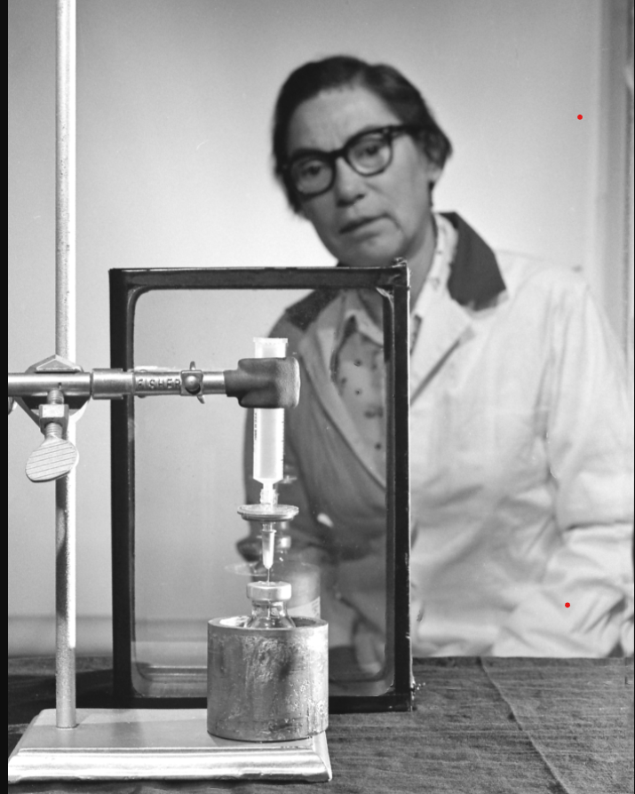

Slide 8

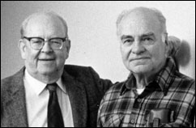
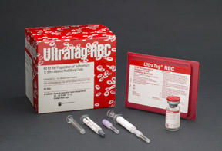
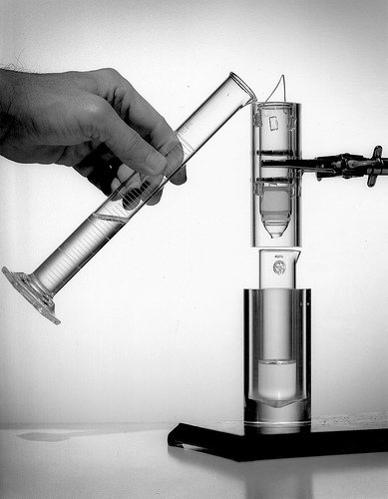
Technetium (Tc) – 99m
Used as a Medical Tracer
Most common radioisotope used in diagnosis, with over 40 million procedures worldwide per year
AEC*
BNL
Industry
Development
Foundation
Market
Inventors
Walter Tucker and Powell Richards
Used for blood pool imaging, including cardiac first pass and gated equilibrium imaging and for detection of sites of gastrointestinal bleeding
Tc-99m Generator
Other medical applications include:
Bone scans
Functional brain imaging
Immunoscintigraphy
Pyrophosphate for heart damage
Labeled Red Blood Cells
* DOE (Formerly AEC)

Slide 9
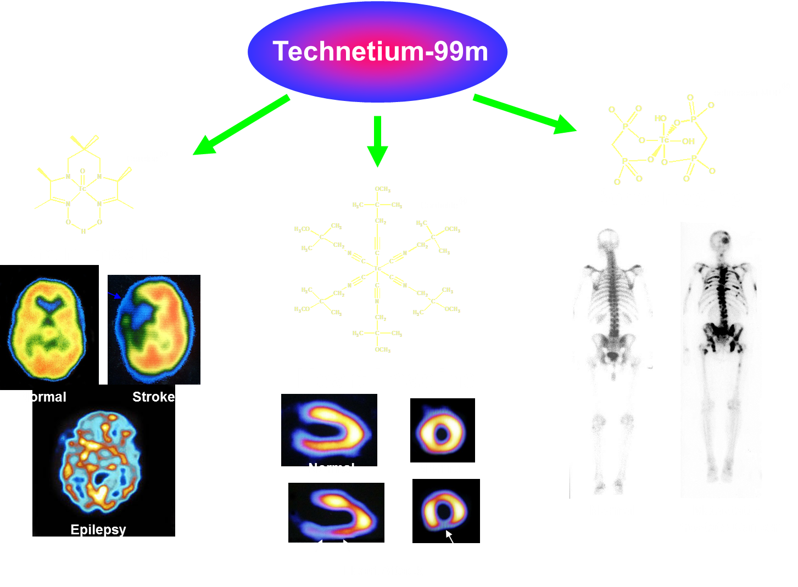
Notes:
Molecular imaging using nuclear techniques has become fairly standard and most of what is needed can be purchased off the shelf by most Universities, hospitals, companies and national labs and put into operation. However, once you start discussing therapy you no longer are able to purchase what you need off the shelf. The activities are much higher and it becomes necessary to have very specialized facilities and experience to produce and handle the activities required. Most of what is needed is specially designed and made for the given application.

Slide 10
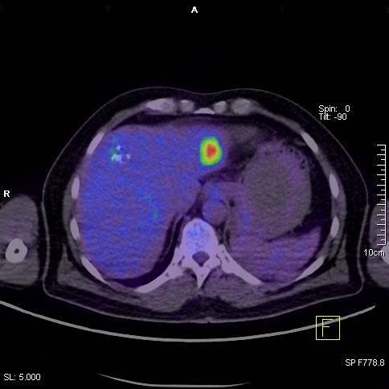
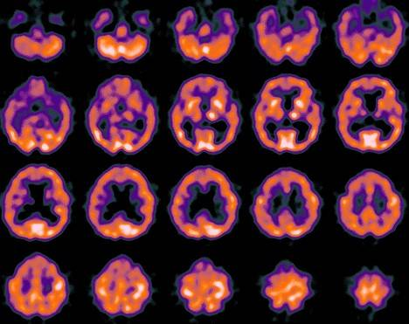
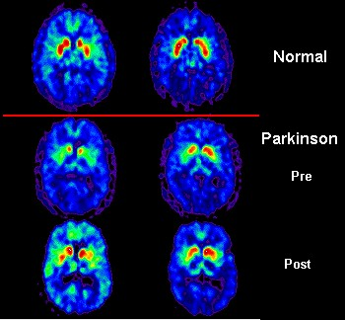
What Is Molecular Imaging?
Visualization
Measurement
Characterization
of biological processes at the molecular and cellular levels in humans and other living systems
Notes:
Here is the definition of Molecular imaging. But what exactly does this mean?
Molecular imaging is the use of imaging technologies to assess biological activity in the body. It provides a way to see, define and determine the biology of diseases (such as cancer and Alzheimer’s disease) and improve patient care.

Slide 11
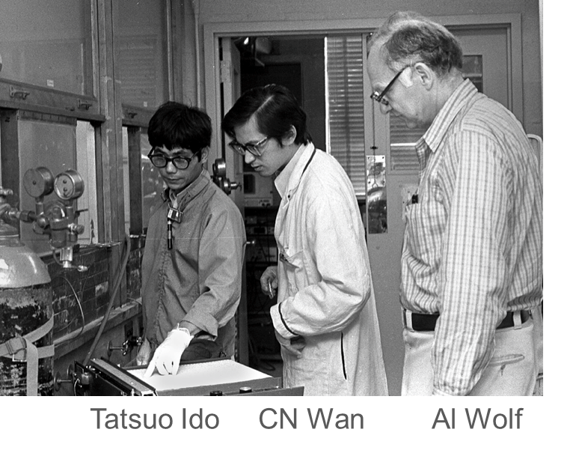
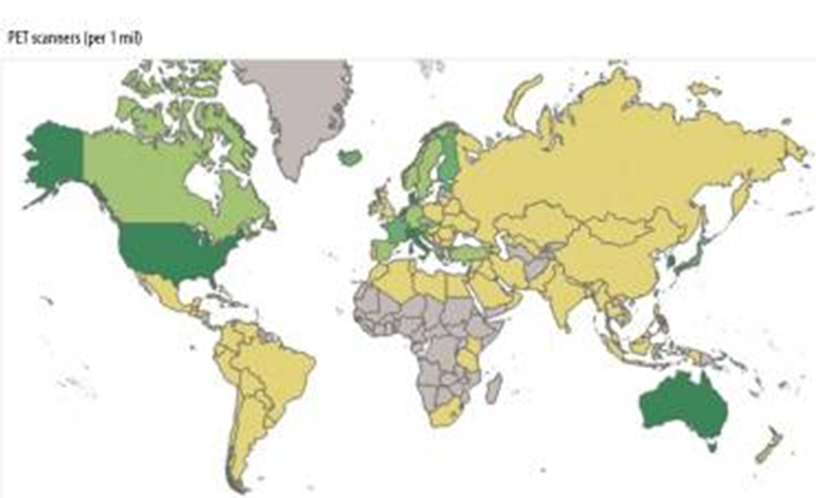
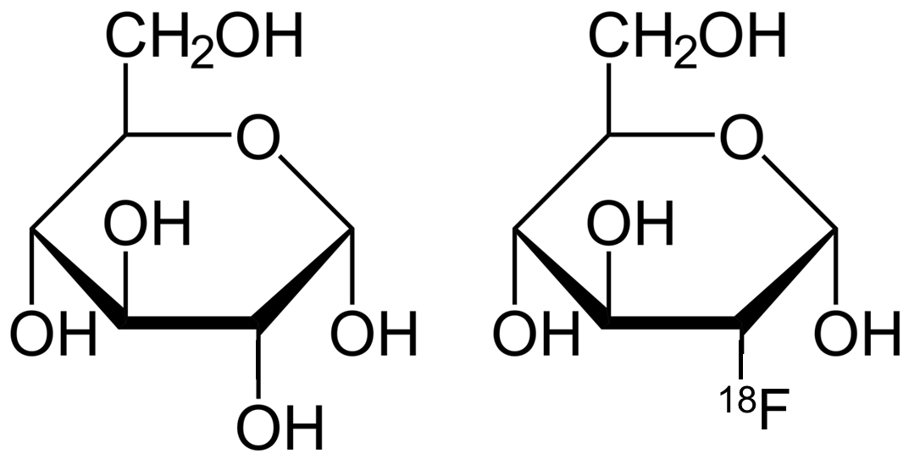
Development of FDG at BNL
Basic Research
Development
Application
Circa 1976
Labelling a sugar molecule (glucose) allows the accurate measurement of energy utilization.
Distribution of PET scanners in the world
Richard Lambrecht and Ron Finn made the isotope (Fluorine-18) on the 60” cyclotron, and Tatsuo Ido and C.N. Wan developed a synthesis of FDG under the direction of Joanna Fowler and Al Wolf.
Avg 1495 PET scans per scanner for a total in the world of about 8 million scans per year
Glucose
¹⁸FDG
By labelling in a specific position (2 position) this prevents complete metabolism of the sugar.

Slide 12
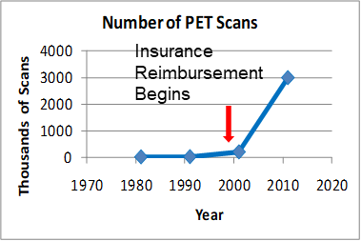

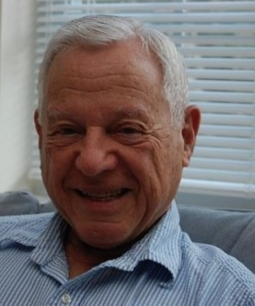
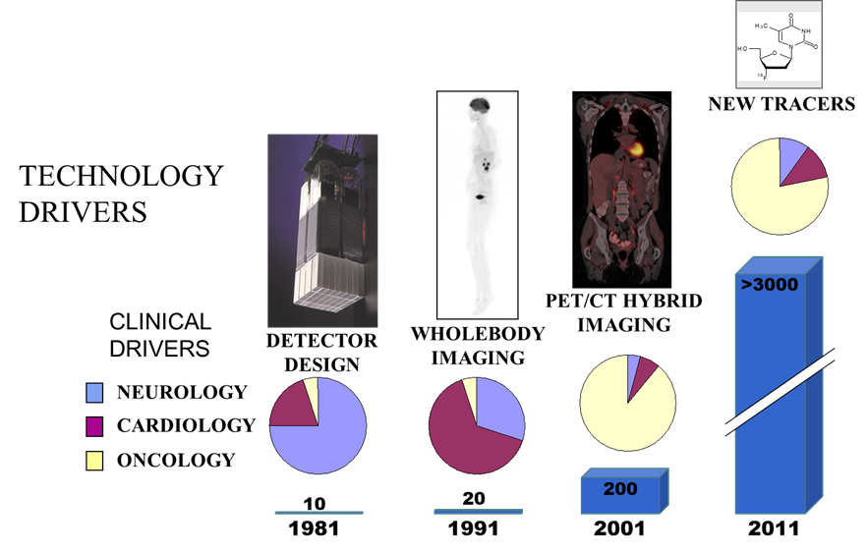
First Report of ¹⁸FDG Uptake in Tumors
Basic Research
Development
Application
Soon after the development of FDG, interest grew in the Medical Department about the use as an energy utilization marker in other applications
In 1980 they published the results
The use for cancer gradually grew clinically
Most of the 8 million PET scans done each year are for cancer diagnosis or treatment assessment
Prantika Som
Dr. Hal Atkins
In the late 70’s Prantika Som and Hal Atkins investigated the use of FDG for cancer diagnosis

Slide 13
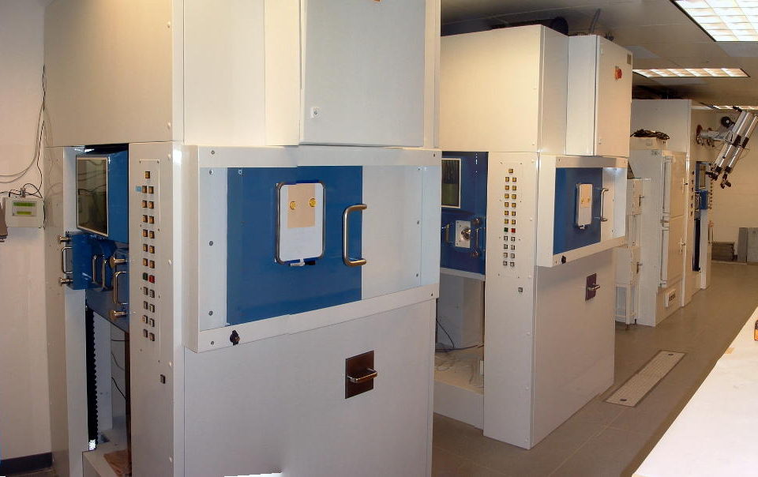
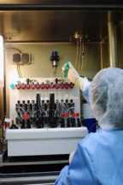
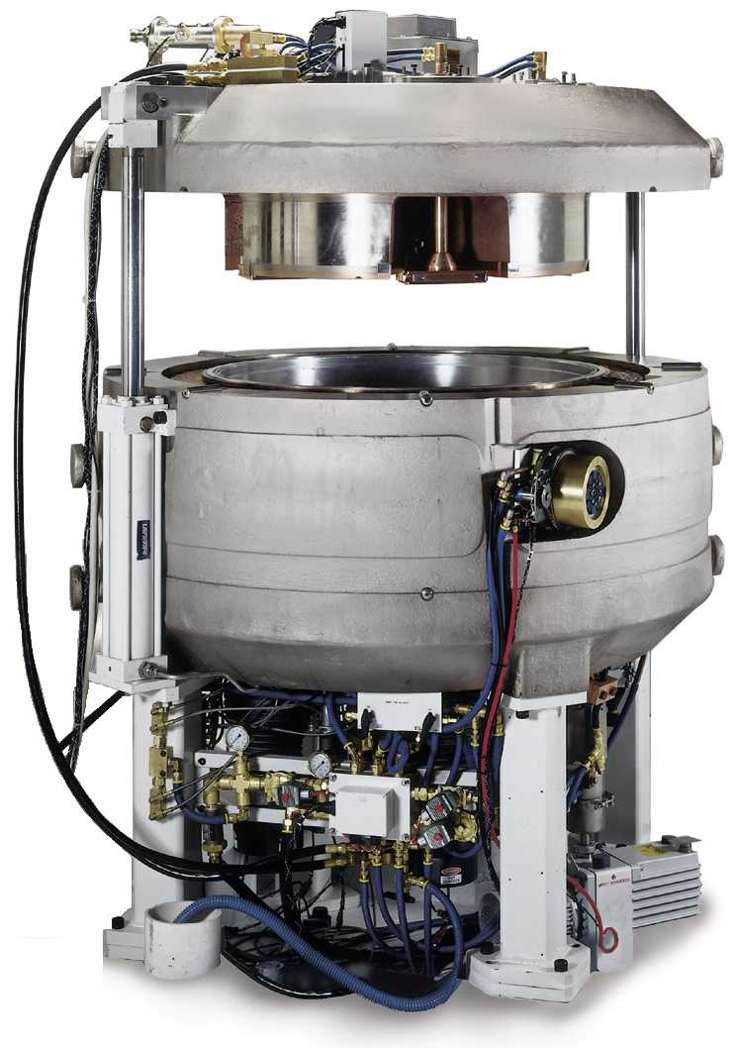
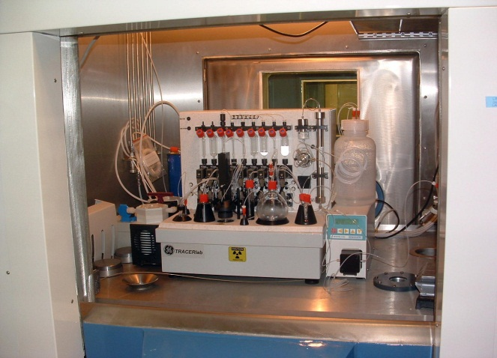
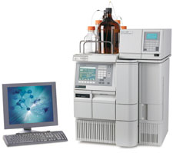
How are accelerator radiopharmaceuticals produced?
QA/QC

Slide 14
Breakdown of Cyclotrons Worldwide and Energy
1400
30 MeV or Below
130
70 MeV or below
Worldwide in the 10’s

Slide 15
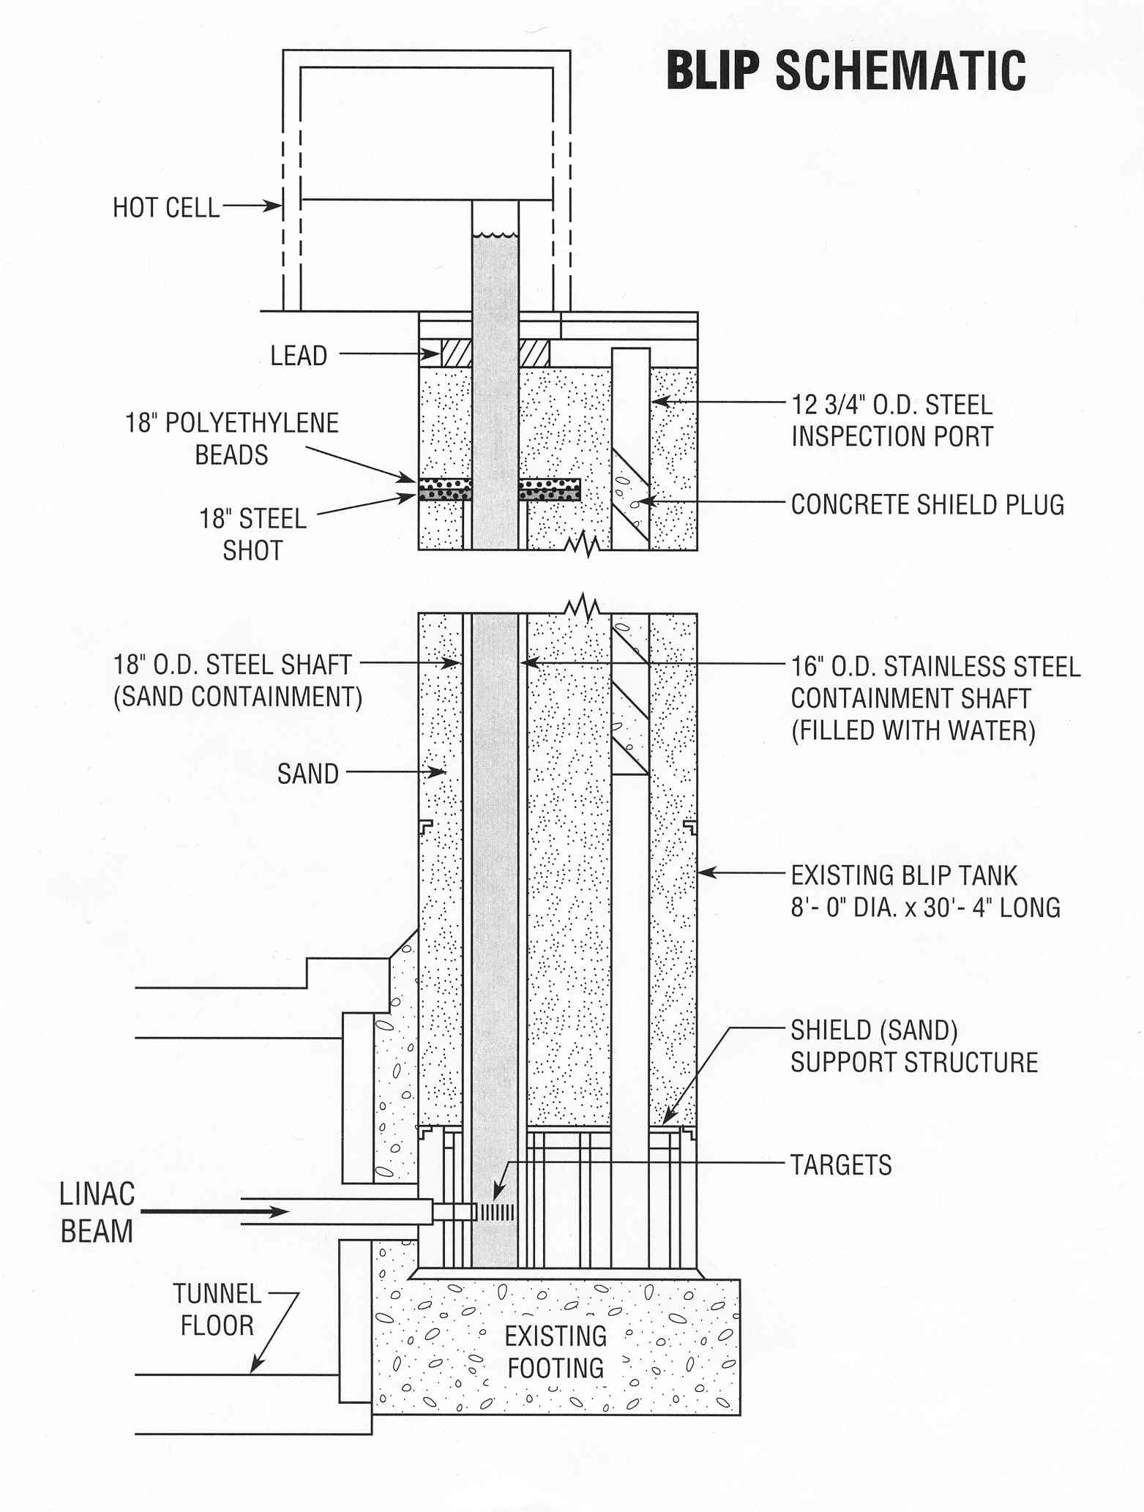
Brookhaven Linac Isotope Producer (BLIP)
BLIP target stack
30 MeV (C-slot)
BLIP schematics
68 MeV
93 MeV
110 MeV
RbCl 2
RbCl 1
Proton beam
Target basket
Cooling water

Slide 16
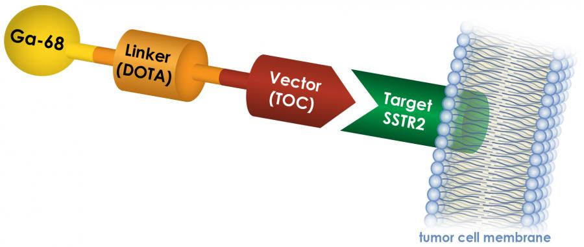

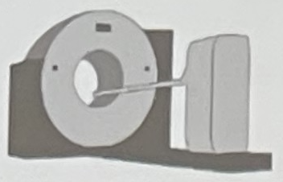
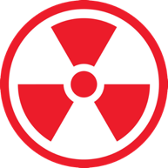
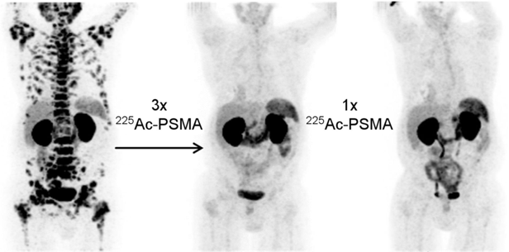
Theragnostics
Theragnostics
  one radioactive drug is used to identify (diagnostic), and a second radioactive drug is used to treat (therapeutic) cancerous tumors and/or metastases.
Treat what we see, see what we treat.
Dx
Tx

Slide 17
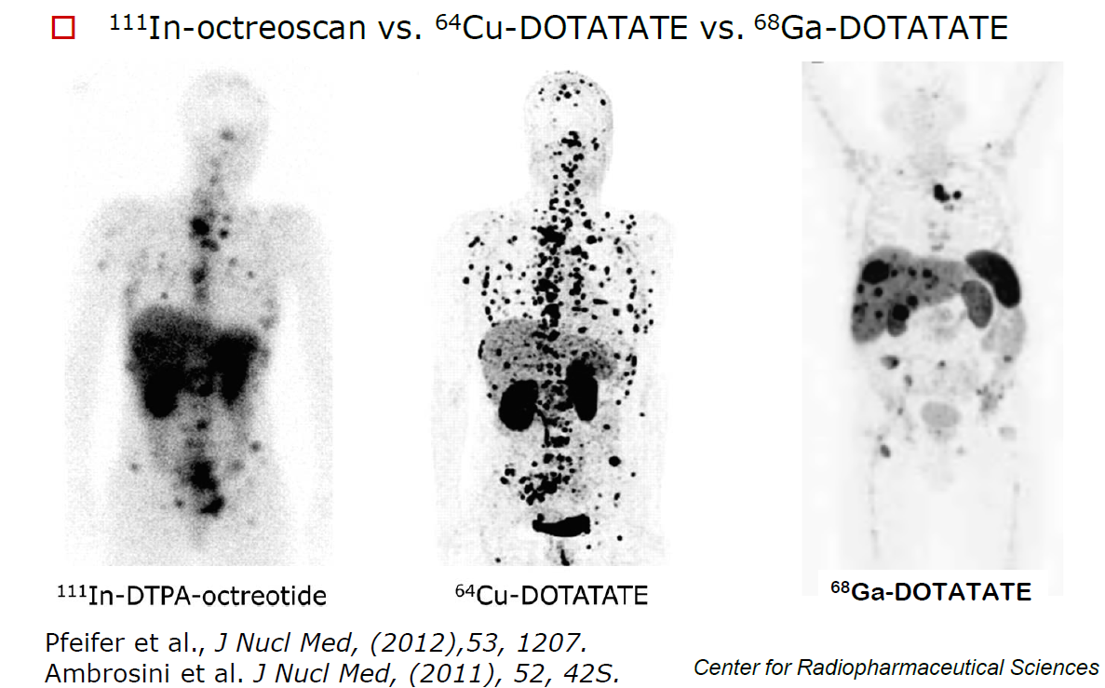
Peptide Receptor Imaging

Slide 18
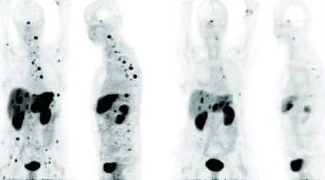
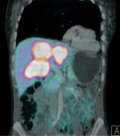
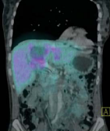
“Remarkable response to Bi-213-DOTATOC observed in tumors resistance to previous therapy with Y-90/Lu-177-DOTATOC”
Before
After
Ga-68 DOTA-TOC
Before
After
Case II: Response of multiple liver lesions after i.a. therapy with 14 GBq ²¹³Bi DOTA-TOC
Case I: Shrinkage of liver and bone metastases after i.a. therapy with 11 GBq ²¹³Bi DOTA-TOC
Abbreviated decay chain: ²²⁵Ac→ ²²¹Fr→ ²¹⁷At→ ²¹³Bi
GEP-NET = Gastroenteropancreatic neuroendocrine tumors
Ref. Morgenstern et al. J. Nucl Med 2012; 53 (Supplement 1): 455.
High publicity: Study awarded Society of Nuclear Medicine Image of the year in 2012
SNMMI press release June 11, 2012

Slide 19

High Specific Activity ⁷²As – theragnostic pair to ⁷⁷As
Imaging Isotope ⁷²As (T_{1/2}= 26 h)
Positron energy comparison
No-carrier added As-72 can be obtained from ⁷²Se/⁷²As generator
Accelerator production of ⁷²Se from ^{nat}RbBr(p,x) at high energy and ⁷⁵As(p,4n) at intermediate energy has been reported
We are interested in ⁷⁵As(p,4n) production route for which excitation functions up to 45 MeV have been reported
Isotope | ⁸⁹Zr (3.27 d) | ⁶⁸Ga (67.7 m) | ¹²⁴I (4.18 d) | ⁷²As (26 h)
Mean E_{β}⁺, keV | 396 (22.7%) | 829.5 (88.9%) | 870 (22.7%) | 1170 (87.8%)
(p,4n)
(p,n)

Slide 20

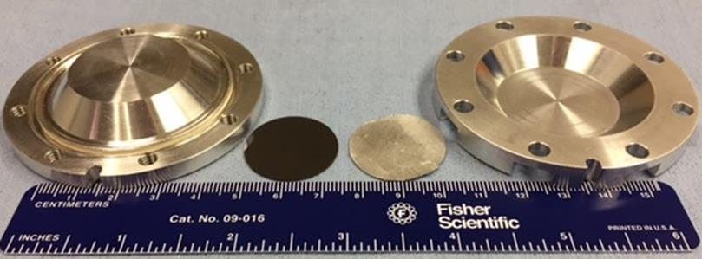
Measurements of ⁷⁵As(p,x) excitation functions above 45 MeV*
Work done by Dr. Anthony DeGraffenreid
Irradiation conditions:
Target material: GaAs foil, d×h=2.5×0.00254 cm
Beam current: ~30 µA, focused beam
Irradiation time: 2 h
Incident energy: 117 MeV incident, lower points achieved by degradation with Al degraders
Aluminum foil used for beam monitoring

Slide 21
Excitation functions for Se-75 and Se-72 production from As

Slide 22

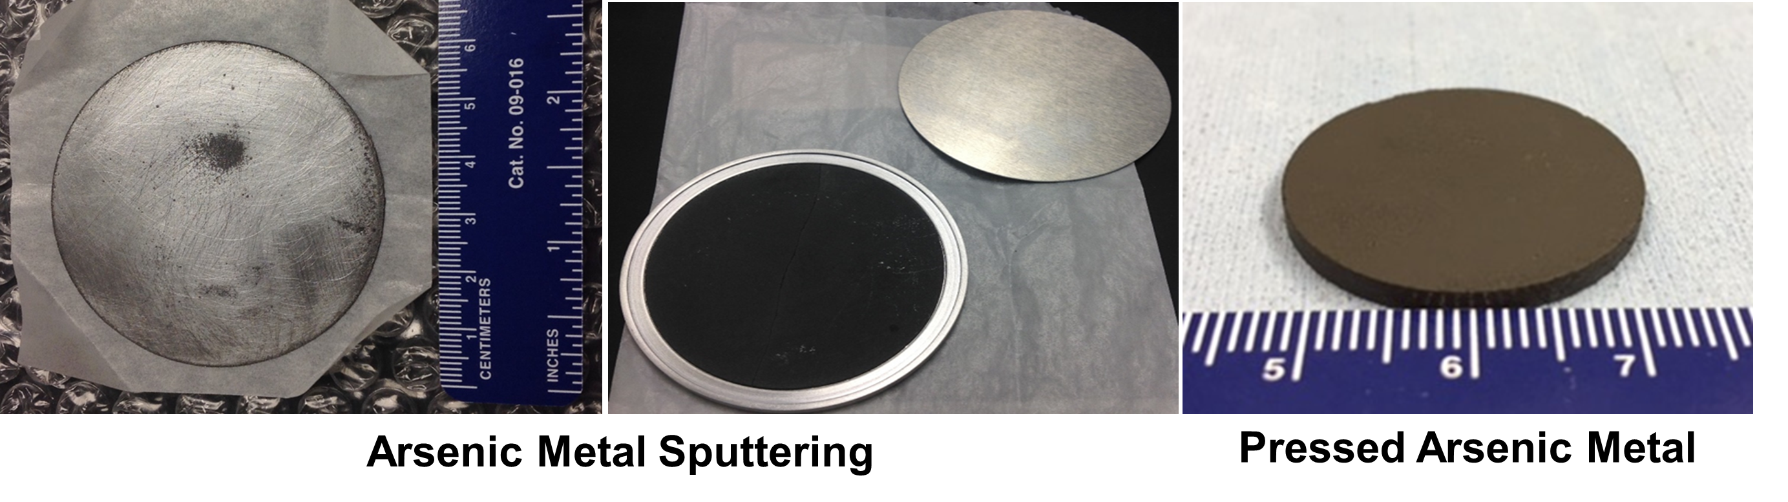
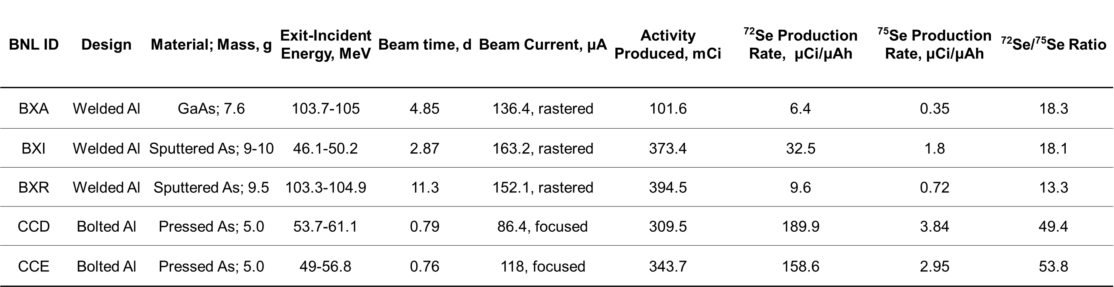
Large scale production of ⁷²Se at 105-103.5 MeV

Slide 23
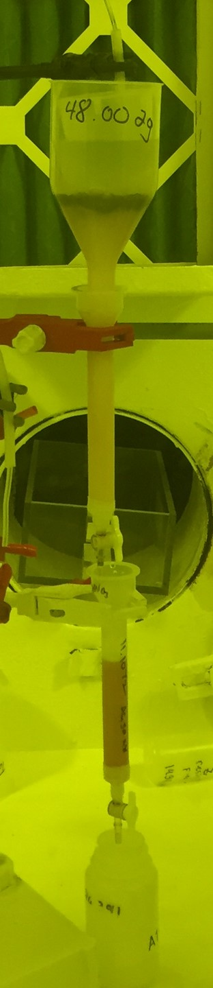
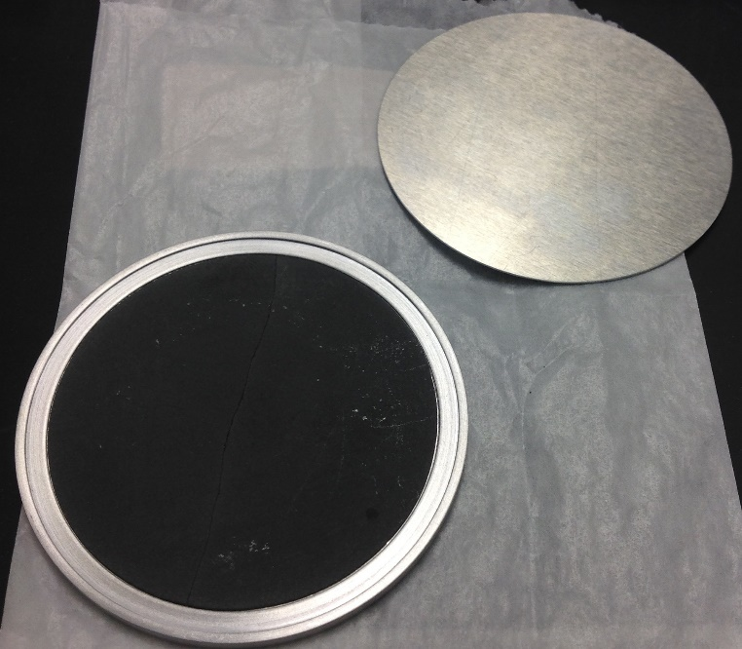
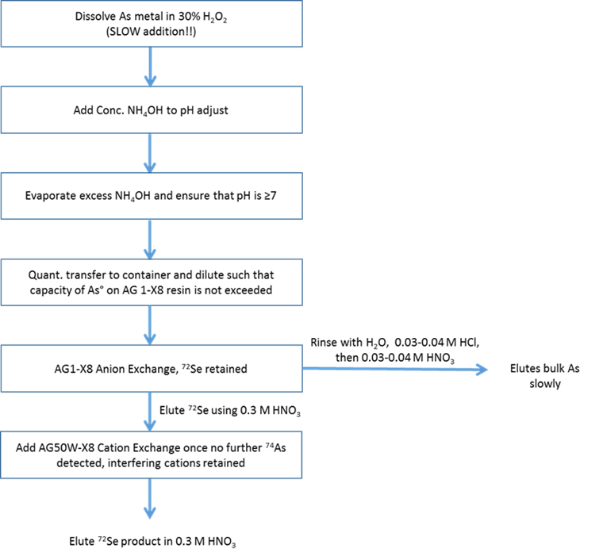
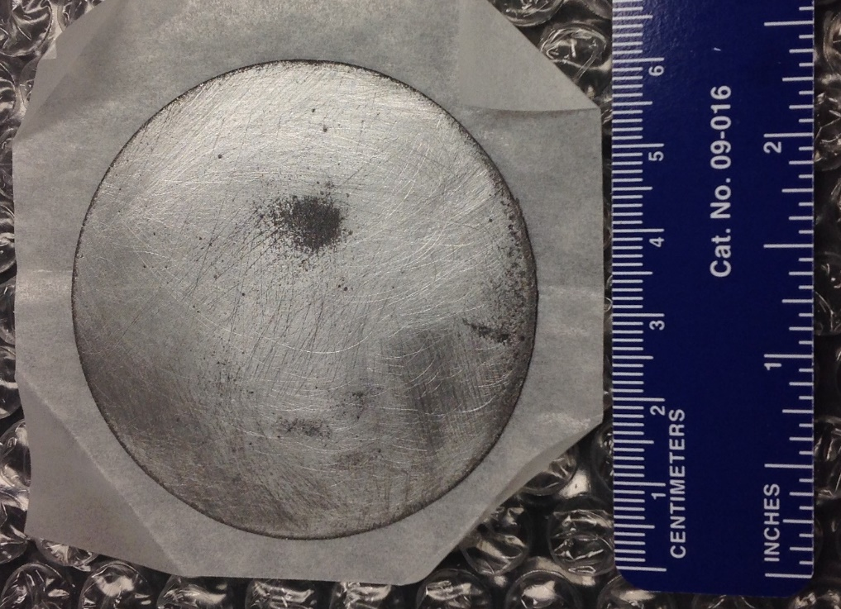
Chemical Processing

Slide 24
⁷²Se/⁷²As Generator
Anion exchange
AG1-X8 (200-400 mesh)
  5 mL BV
Load in 0.3 M NH₄OH
Rinse H₂O
Rinse dilute HCl
Collect each fraction to determine
percent loaded

Slide 25
⁷²As-Monoclonal Antibodies
Trastuzumab (Herceptin)
  2mg/mL/rxn
Daratumumab
  1mg/mL/rxn
  control
Test against patient specific tumor models
To visually observe
  Drug sensitivity
  Uptake
  Effectiveness
Biomolecule
M-Ligand
Linker

Slide 26
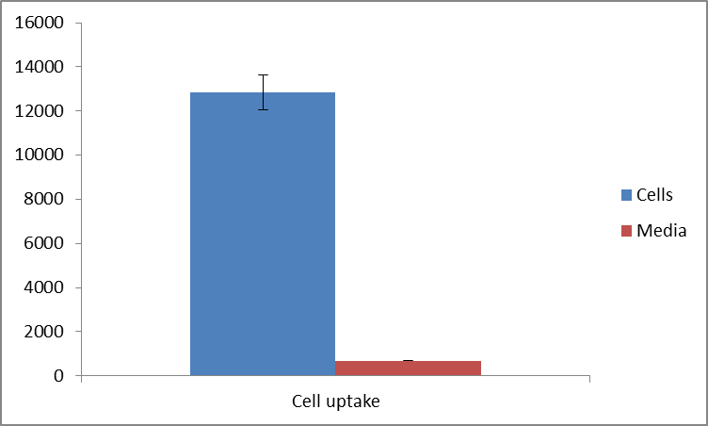
⁷²As-mAb Cell Studies
⁷²As-trastuzumab is incubated with gastric cancer cell lines for a 24 hour period
Cells are separated from the media and analyzed for radioactivity
Gastric Cancer Cell Uptake
Cpm
18.5 times uptake in cells!!!
Completed at Stony Brook University

Slide 27
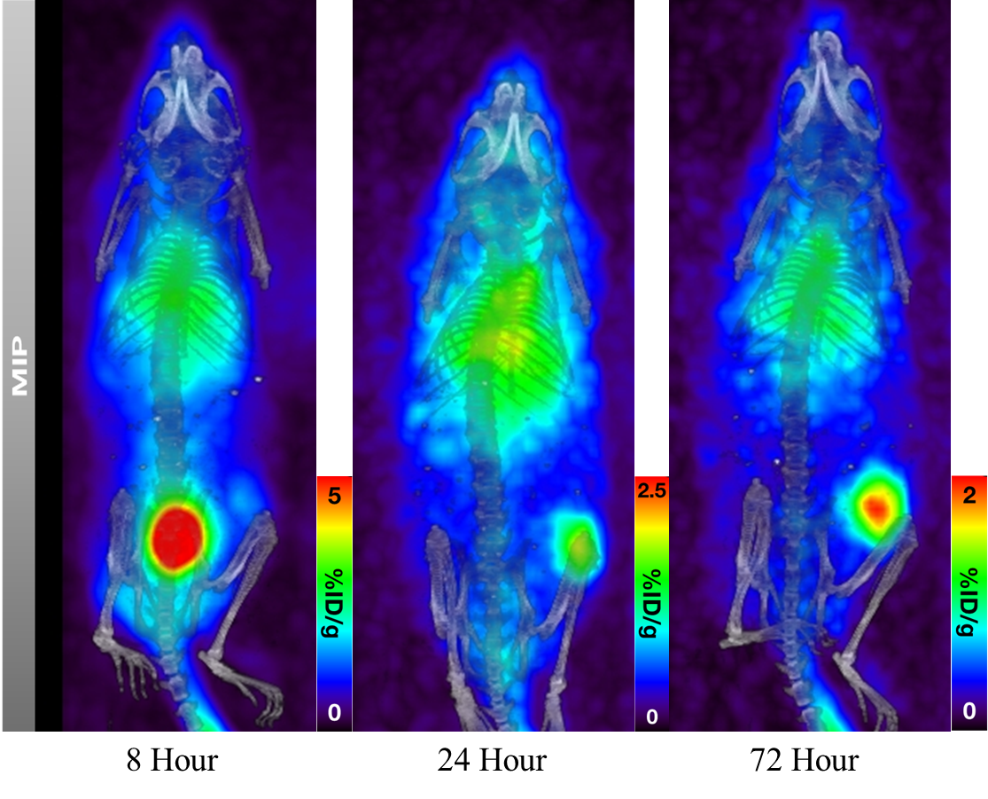
⁷²As-Trasztuzumab in NCI-N87 gastric cancer xenografts

Slide 28



Theranostic radiometals
Elementally matched theranostic radionuclides
(Pseudo)Radiolanthanides theranostic radionuclides
1. Umbricht, C. A et al. 44Sc-PSMA-617 for radiotheragnostics in tandem with 177Lu-PSMA-617—preclinical investigations in comparison with 68Ga-PSMA-11 and 68Ga-PSMA-617. EJNMMI Research 2017
2. Chernysheva, M., et al. Accelerator Production of Scandium Radioisotopes: Sc-43, Sc-44, and Sc-47. Curr Radiopharm 2021

Slide 29


Production methods for ⁴⁴Sc
Cyclotron
Generator
⁴⁴Ca(p,n)^{44g}Sc/^{44m}Sc
⁴⁷Ti(p,α) ^{44g}Sc/^{44m}Sc
Generator allows for sites without a cyclotron to obtain high radionuclidic purity ⁴⁴Sc
⁴⁴Ti (t_{1/2}=58.9 y) can lead to a long-lasting generator
Becker, K.V., et al. Cyclotron production of ⁴³Sc and ^{44g}Sc from enriched ⁴²CaO, ⁴³CaO, and ⁴⁴CaO targets. Front Chem 2023
Cingoranelli, S.J., et al. Production and purification of ⁴³Sc and ⁴⁷Sc from enriched [⁴⁶Ti]TiO₂ and [⁵⁰Ti]TiO₂ targets. Sci Rep 2023
Schmidt, C., et al. Current State of ⁴⁴Ti/⁴⁴Sc Radionuclide Generator Systems and Separation Chemistry Curr Radiopharm 2024

Slide 30






Preclinical applications
[⁴³Sc]Sc-PSMA-617 PET Imaging
[⁴⁷Sc]Sc-PSMA-617 SPECT Imaging
1 h LNCaP
4 h LNCaP
24 h LNCaP
48 h LNCaP
Manuscript in preparation for Molecular Pharmaceutics

Slide 31

Images Obtained with PSMA Ligands
PC-3 PIP = PSMA^{pos} tumor, PC-3 flu = PSMA^{neg} tumor; Ki = Kidney, Bl = bladder

Slide 32


First-in-Man Using ⁴⁴Sc-PSMA-617

Slide 33


Clinical applications of ⁴⁴Sc
[⁴⁴Sc]Sc-DOTATOC
[⁴⁴Sc]Sc-PSMA-617
PET/CT whole body images at different time points post-injection using [⁴⁴Sc]Sc-PSMA-617: (A) 30 min (B) 120 min (C) 19 h.¹
2nd cartridge
Whole-body PET scans presented as MIP of (A) Patient 1 and (B) Patient 2 at 4 hours after injection of ⁴⁴Sc-DOTATOC¹
⁴⁴Sc was obtained from ⁴⁴Ti/⁴⁴Sc generator²
4 patients were administered with an average of 1.36 ± 0.25 mCi²
[⁴⁴Sc]Sc-PSMA-617 was revealed more similar characteristics to [¹⁷⁷Lu]Lu-PSMA-617 than the routinely used [⁶⁸Ga]Ga-PSMA-11³
⁴⁴Sc was produced by the ⁴⁴Ca(p,n)⁴⁴Sc¹
2 patients were administered with an average of 2.36 ± 0.23 mCi¹
1. Singh, A.; et al. First-in-Human PET/CT Imaging of Metastatic Neuroendocrine Neoplasms with Cyclotron-Produced ⁴⁴Sc-DOTATOC: A Proof-of-Concept Study. Canc Biother Radiopharm 2017
2. Khawar, A.; et al. [44Sc]Sc-PSMA-617 Biodistribution and Dosimetry in Patients With Metastatic Castration-Resistant Prostate Carcinoma. Clin Nucl Med 2018
3. Eppard, E.; et al. Clinical Translation and First In-Human Use of [(44)Sc]Sc-PSMA-617 for PET Imaging of Metastasized Castrate-Resistant Prostate Cancer. Theranostics 2017.

Slide 34


Physicochemical characteristics of β-emitters and α-emitters
β-emitters
Intermediate LET radiation (0.50–2.30 MeV) ; long range in tissues (1–12 mm of tissue penetration).
β-particles range: target clusters of cells (from 10 to 1,000 cells)
α-emitters
High-LET radiation (60–230 keV/μm)
Short to intermediate path length (²¹²Pb: 50–80 μm) in tissues
Path length: target several cells (2–10 cells)
High LET causes Irreversible damage of double stranded DNA
Slide courtesy of Dr. M. McDevitt, Memorial Sloan Kettering

Slide 35

M. Makvandi et al (2018) Targeted Oncology 13: 189-203

Slide 36


Overview of ongoing targeted alpha therapy clinical trials [3]
Actinium-225 (9.2 d) Demand
27 molecules labeled with ²²⁵Ac are presently under development, among which 13 have already reached human test level¹
The first ²²⁵Ac-radiopharmaceutical has entered the clinical phase III stage and might reach the market by 2028
Patient doses, as informed by clinical trials, are estimated at 1.1-2.4 mCi per patient kg²
Considering pre-injection decay, ~80 Ci at end of bombardment would be sufficient to treat 100,000 patients each year
²²⁵Ac emits four α-particles down to stable ²⁰⁹Pb [3]
¹Zimmermann, R., Is Actinium Really Happening? J Nucl Med, Aug 2023
²Jang, A., et al., Targeted Alpha-Particle Therapy: A Review of Current Trials, Int. J. Mol. Sci. 2023, 24(14), 11626.
³Pallares, R.M, Abergel, R.J., Development of radiopharmaceuticals for targeted alpha therapy: Where do we stand?, Front. Med. 2022, Vol.9

Slide 37
Addressing the Supply Chain: Various ²²⁵Ac/²²⁹Th Production Routes
Facility | Nuclear Reaction
Reactor (thermal neutrons) | ²²⁶Ra(3n,g)²²⁹Ra →²²⁹Ac→²²⁹Th (plus ²²⁸Ra target)
Accelerator (electrons) | ²²⁶Ra(g,n)²²⁵Ra→²²⁵Ac
Accelerator (low energy particles) | ²²⁶Ra(p,2n)²²⁵Ac ²²⁶Ra(a,n) ²²⁹Th ²²⁶Ra(p,pn) ²²⁵Ra ²³²Th(p,x) ²²⁹Th
Accelerator (high energy particles) | ²³²Th(p,x)²²⁵Ac ²³²Th(p,x)²²⁵Ra→²²⁵Ac
Accelerator (high energy neutrons) | ²²⁶Ra(n,2n) ²²⁵Ra
Hot Cell Facility (²³³U processing) | ²²⁹Th decay to ²²⁵Ac

Slide 38



Target Challenge: develop thick Th targets to withstand high beam current to support clinical scale production
Targetry and Inventory
Initial targets were thin Th foils (0.127mm, 0.9g) encapsulated in Al. Used to support small scale production for chemistry development and for ²²⁵Ac cross section determinations.
Next larger diameter (0.38mm thick,13g )BNL targets to support new rastered beam at BLIP were sealed in inconel by electron beam welding.
Primary risk associated with Ci-Scale targets (~100g) is overheating. Capsule MP (1290°C) is lower than thorium MP (1755°C).
Thermal behavior at Th/capsule interface is key.
Thermal calculation for 165μA at 191 MeV incident energy assuming ideal thermal contact for a 3 mm thick target (105g) predicts low peak temperature but actual thermal contact conductance will be lower.

Slide 39

Chemical recovery ~90%, >99% radiopurity, ²²⁵Ac/²¹³Bi generator performance is equivalent to generators prepared from ²²⁹Th-derived ²²⁵Ac.
Preliminary Chemistry Flow Sheet

Slide 40

Processing Facilities at BNL
Commissioned new AP hot cells for processing of Ac-225 to meet growing demand
AP hot cells in routine operations
MIRP put 112 mCi of Ac-225 into inventory by irradiation and processing all conducted here onsite (BLIP and AP hot cell) – great accomplishment!
DOE IP now has two processing sites: ORNL and BNL
Consist of three hot cells, two ready rooms, dedicated ventilation, acid scrubber system, clamshell for target introduction to reduce dose to operators.

Slide 41
Pancreatic Ductal Adenocarcinoma (PDAC)
The most lethal common malignancy
  5 yr survival <10%
Onset of PDAC is typically asymptomatic
  Leads to 80-85% of patients presenting with metastasized disease or locally advanced disease
Surgery- chemo combo is the best chance for survival
PDAC detection at early stages increases survival chances
  There is a need for improved noninvasive detection methods
  The development of an immuno-PET strategy allows for noninvasive target specificity along with PET sensitivity
  ²²⁵Ac radioimmunotherapy allows for treatment while limiting dose to healthy tissues

Slide 42








Single platform for diagnosis and therapy
Imaging agent
Therapeutic agent
Therapeutics + Diagnostics
Positron-emitting
nuclide
(e.g. ⁸⁹Zr)
Therapeutic nuclide
(e.g. ²²⁵Ac)
Theranostics
Targeting agent
(e.g. antibody)
Targeting agent
(e.g. antibody)
Chelator
(e.g. MACROPA)
Chelator
(e.g. DFO)
Notes:
So what is a theranostic? A theranostic...
This approach combines the diagnostic and therapeutic agent into a single platform. For example, with your targeting antibody you can label it with a positron emitter, such as 89Zr, for diagnostic imaging and switch to a therapeutic radionuclide such as 225Ac for radioimmunotherapy.
The chelator will change with the nuclide change, however, since the antibody is the same you will maintain similar specificity for the target.

Slide 43
Summary
The interest in therapeutic radionuclides is growing in leaps and bounds
The production is increasing making radionuclides more readily available
  DOE IP has ramped up its role in the supply with a goal of maximizing the domestic availability.
  Several commercial companies are pursuing production
A robust domestic supply of Ac-225 is being actively pursued in the U.S.
Alternative production approaches are being explored for all alpha-emitters.
These combined with new targeting molecules are resulting in advanced treatments for patients with limited to no options

Slide 44
Questions ?

