Slide 1


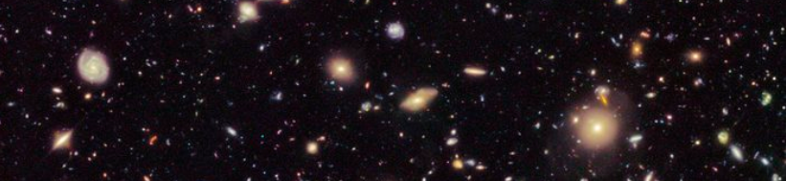

QuarkNet and the American Association of Physics Teachers
An Introduction to:
Everything in the Universe
(that we think we know about)

Slide 2

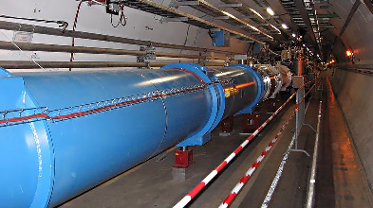
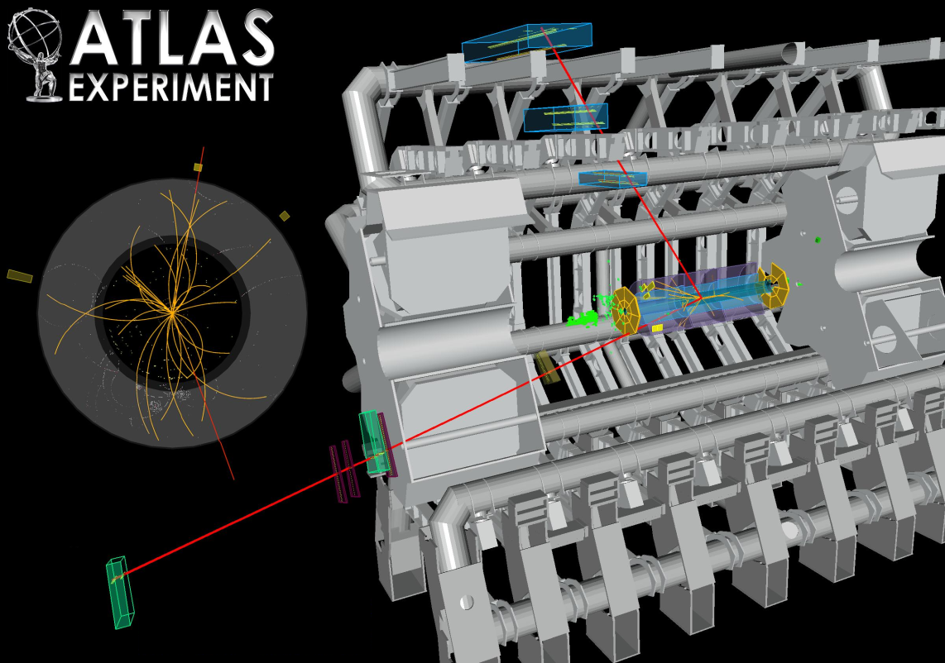
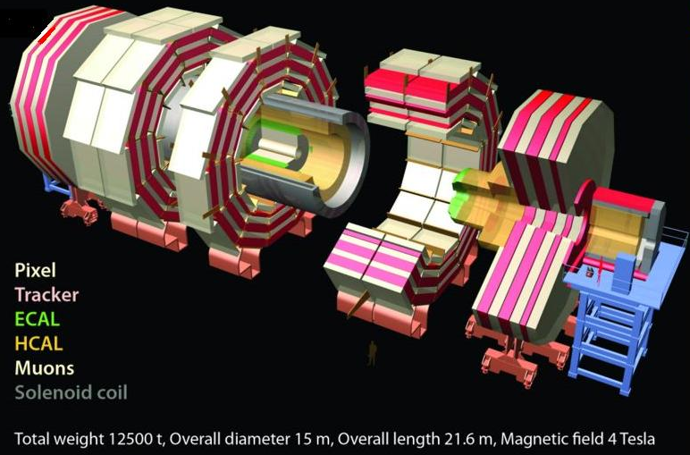
Particle Physics
Particle physicists use really big machines to ask very basic questions about the smallest pieces of matter – fundamental particles!

Slide 3

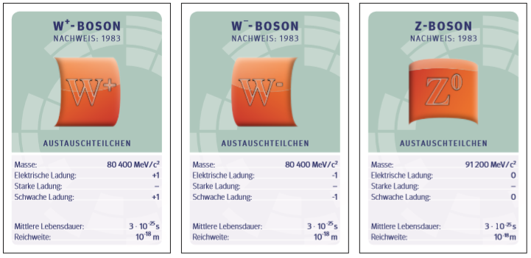
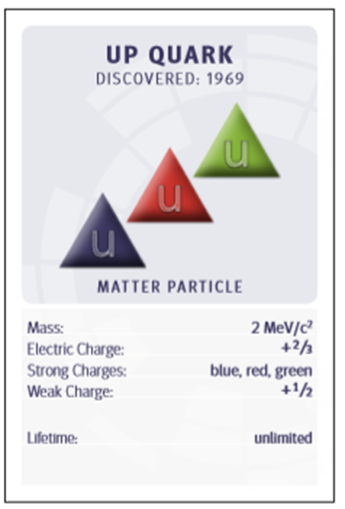
Remember these?
What are they about?

Slide 4
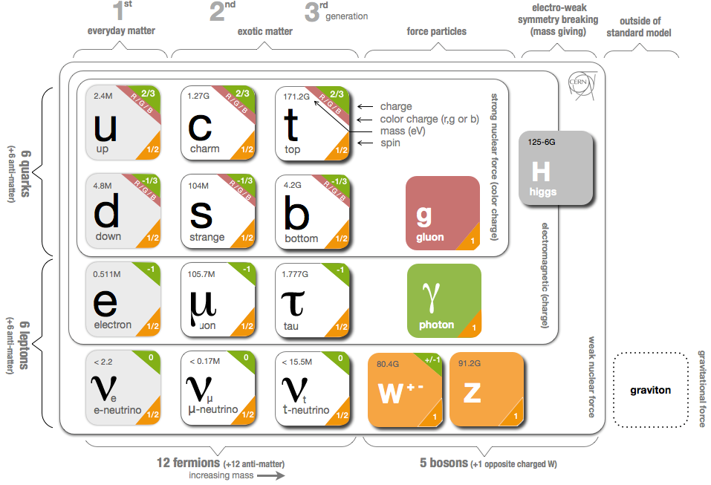
Standard Model

Slide 5
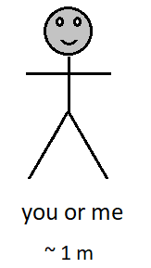
How small?

Slide 6
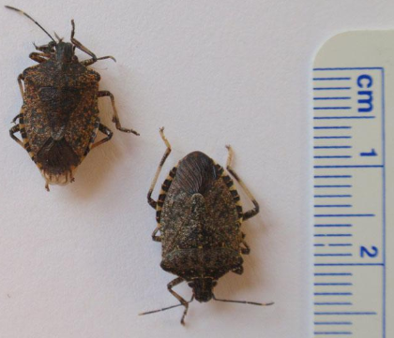


How small?

Slide 7
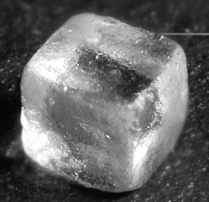



How small?

Slide 8
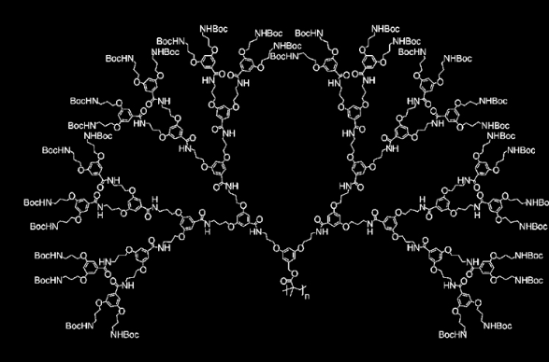


How small?

Slide 9
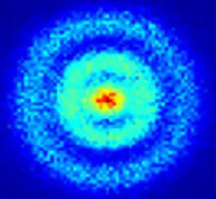


How small?

Slide 10
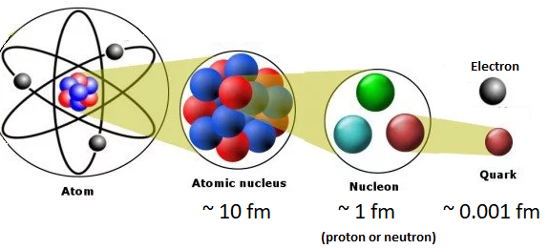



Way small!
one million times smaller than an atom!

Slide 11
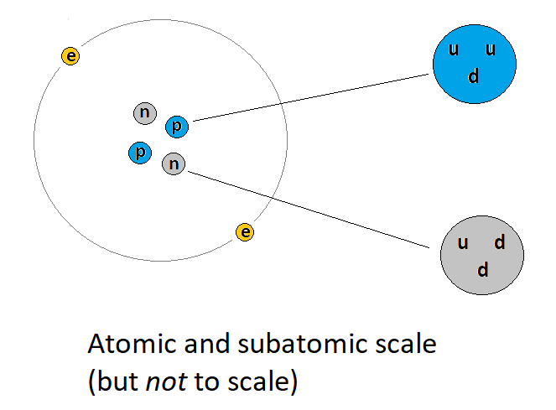
Where it fits

Slide 12
Questions abound
Incomplete list:
Where has all the antimatter gone?
What are dark matter and dark energy?
Why do neutrinos change from one kind to another?
How do particles get mass?
How do particles get mass?
What questions have we not thought of yet?

Slide 13
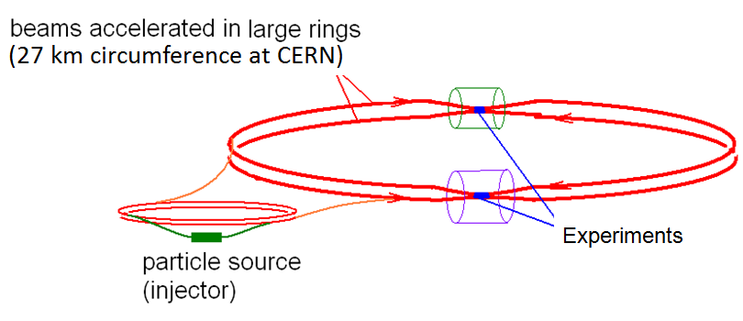
Making really small particles
The Large Hadron Collider (LHC) is buried about 100 m below the surface near the Swiss-French border. It is the highest energy accelerator in the world.

Slide 14
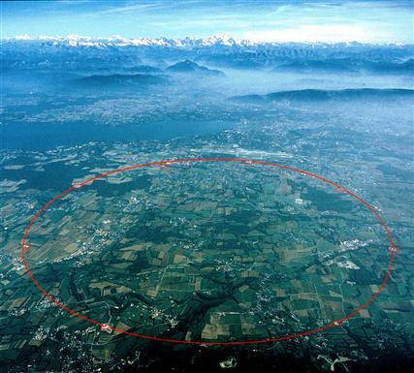
LHC is here

Slide 15
Part of the LHC looks like this

Slide 16
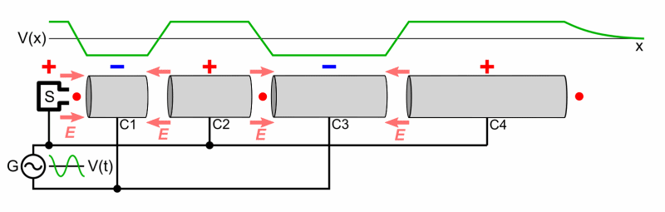
How does it work?
Notes:
Accelerator human demo

Slide 17
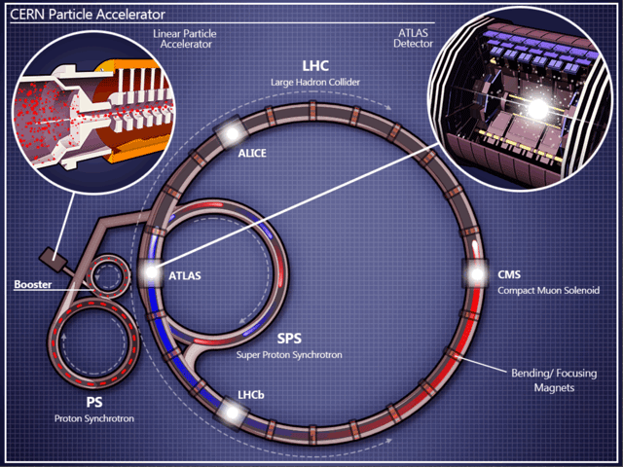
How does it work?
Notes:
Collision human demo

Slide 18
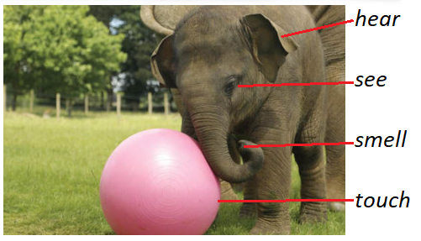
How do we detect things?
Notes:
Collision human demo

Slide 19

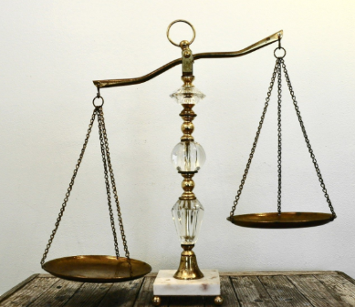

How do we measure things?
How do we measure particles?
Notes:
Collision human demo

Slide 20
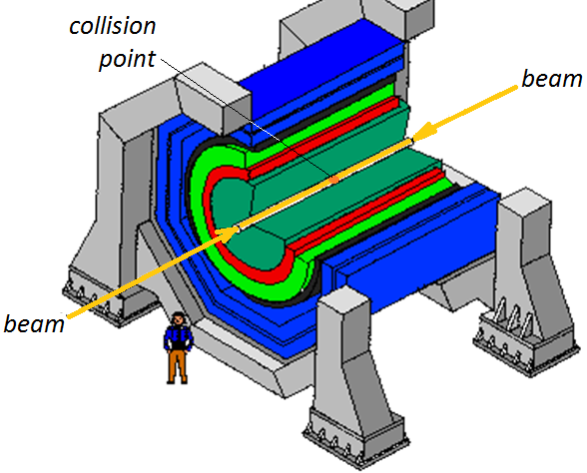
Collider detector (generic)
Generic Design
Cylinders wrapped around the beam pipe
From inner to outer . . .
Tracking
Electromagnetic calorimeter
Hadronic calorimeter
Magnet*
Muon chamber
* location of magnet depends on specific detector design

Slide 21
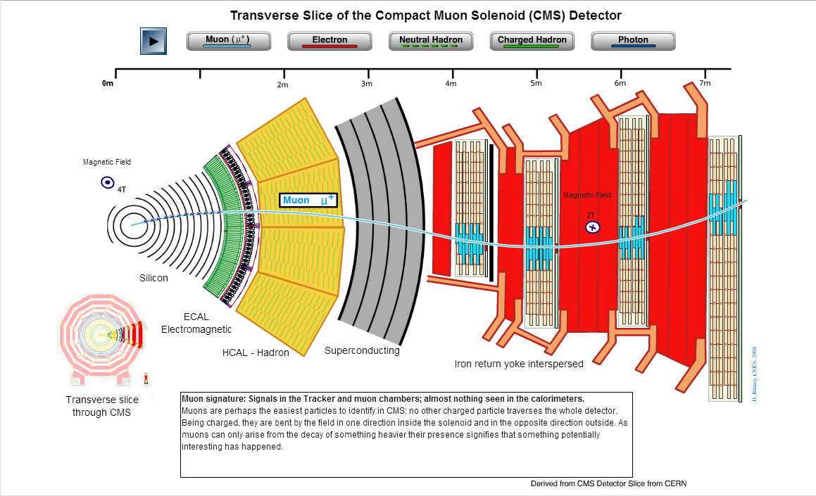
How does it work?
Notes:
Collision human demo

